Slide 1
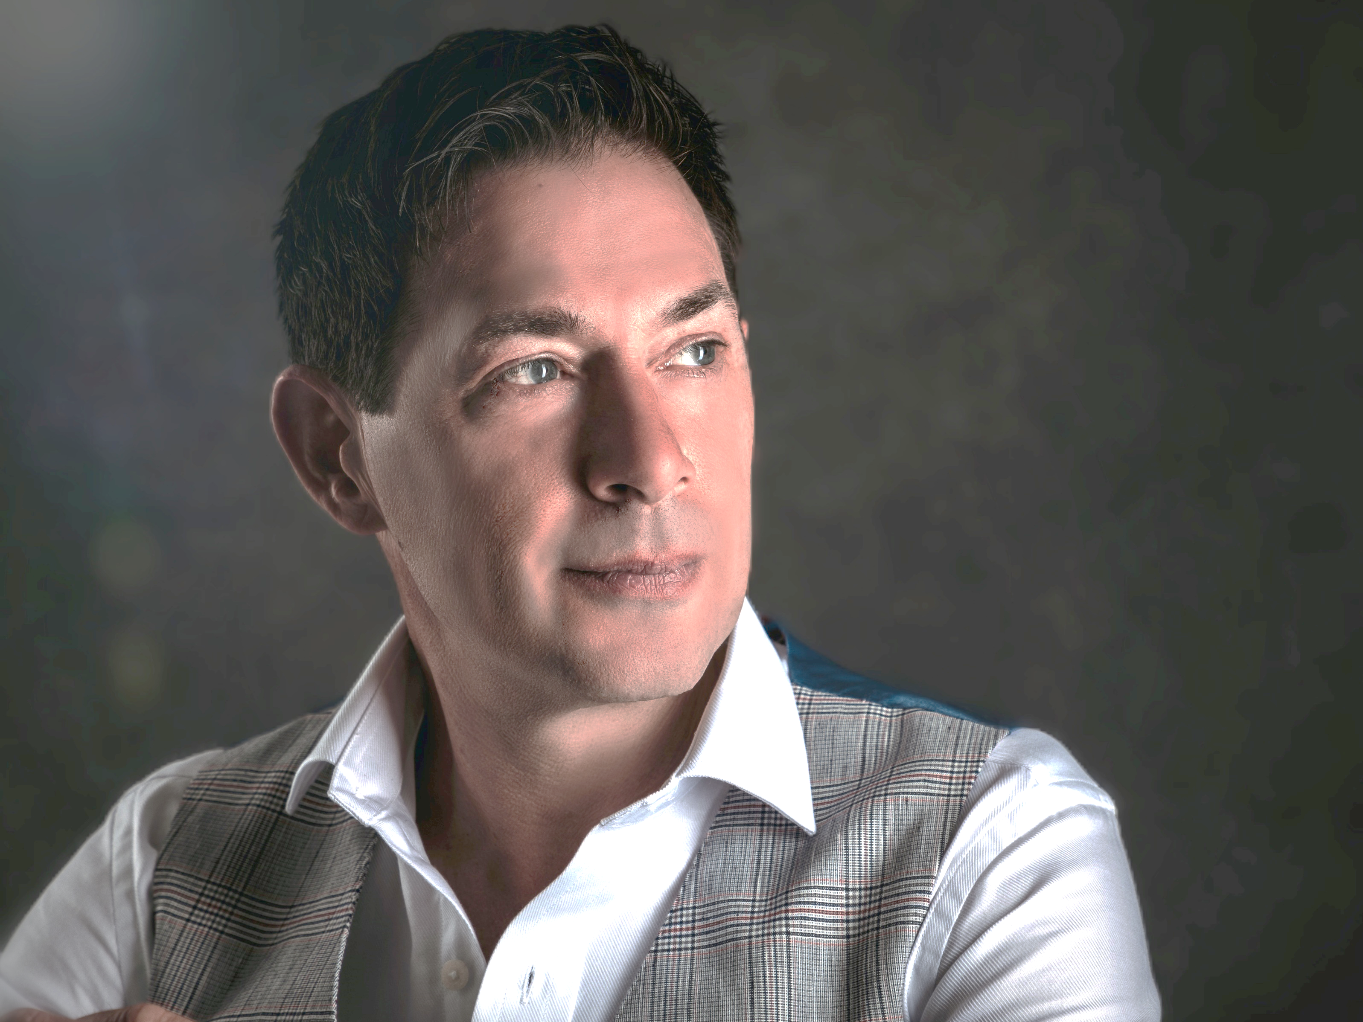
POLDARK
INTERNATIONAL CABARET STAGE HYPNOTIST & MIND MYSTERIES PERFORMER

Slide 2
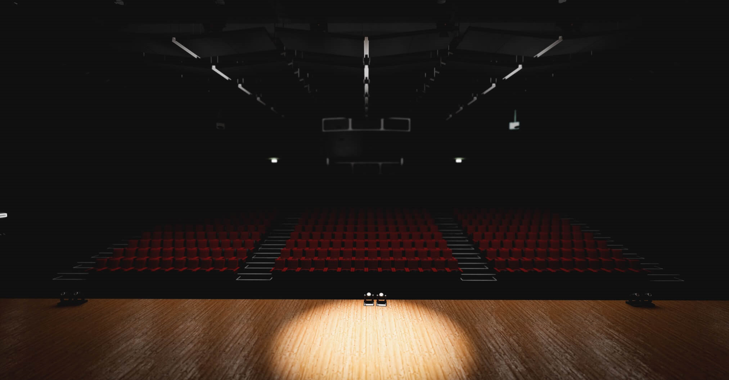






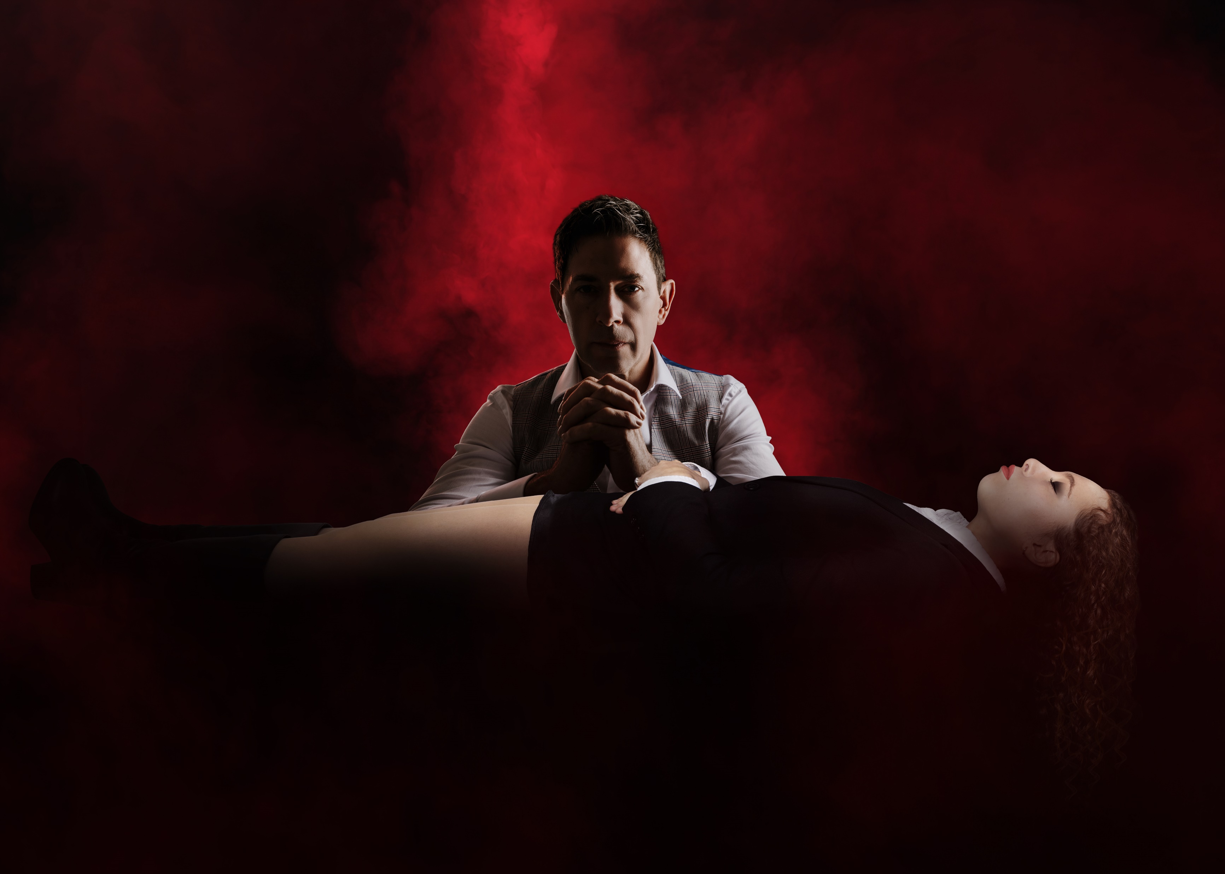
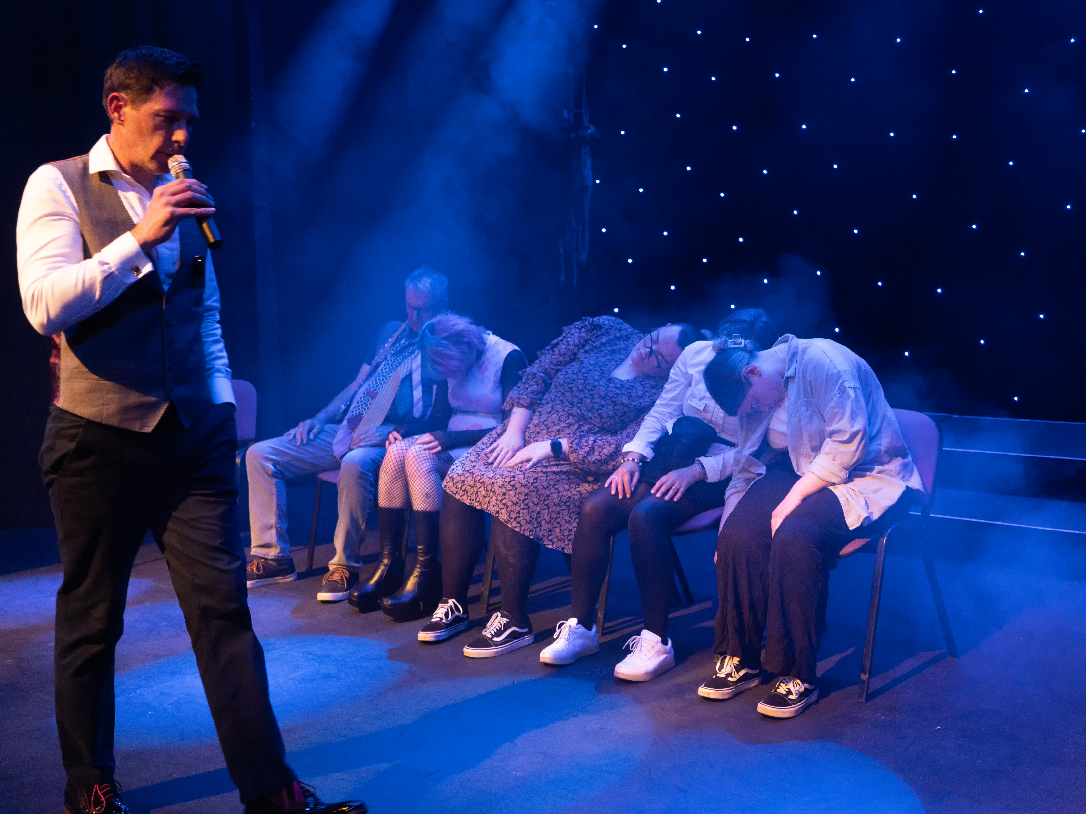
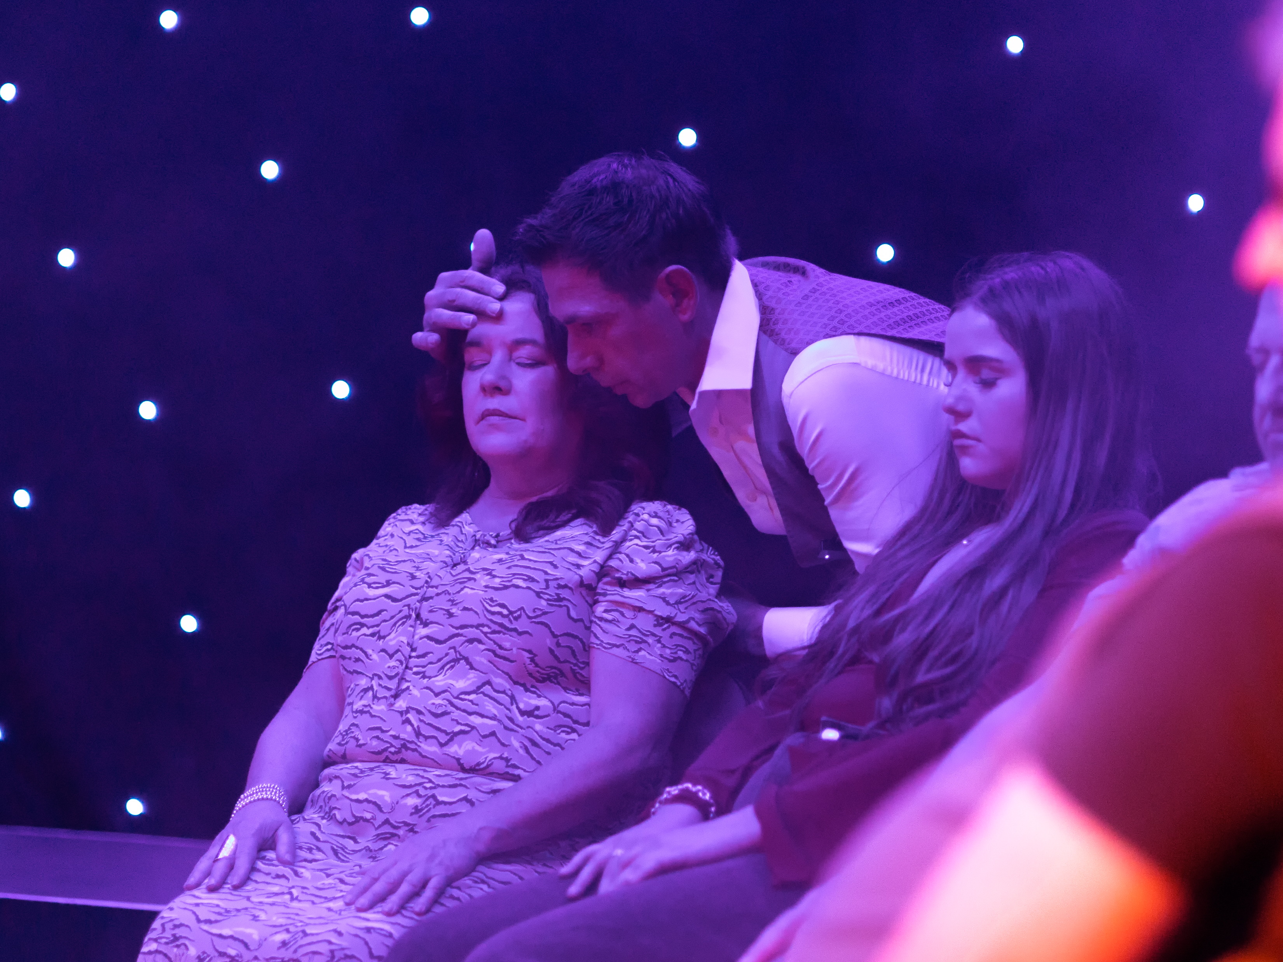
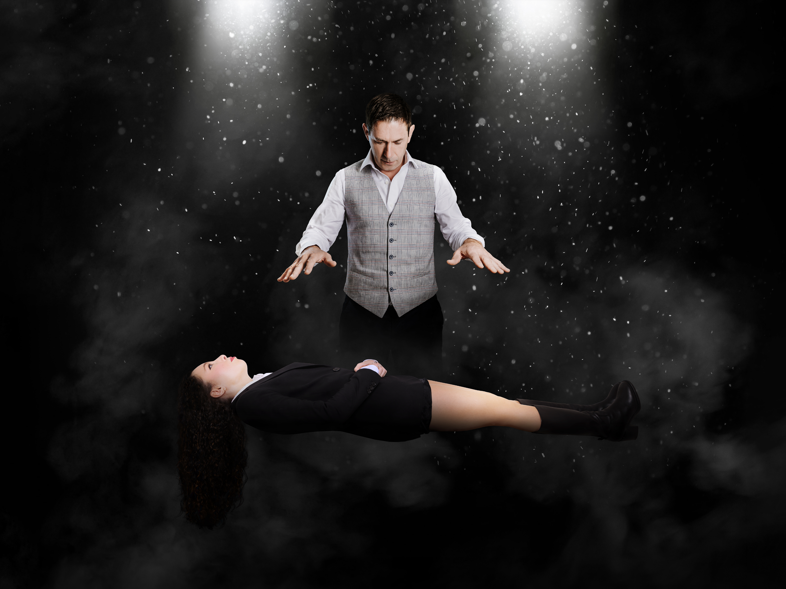
With an extremely interesting back story, Poldark is privileged to be part of a small unique handful of 'naturally' gifted hypnotists. Today, he is the only remaining one.
A master hypnotist with over 30 years’ of experience traveling the world, performing to corporate, private and public clients. Powerful, mind-blowing mesmerising performances, with demonstrations of hypnotic phenomena and the power of the mind, such as telepathy, ESP, sixth sense, psychometry and mentalism. Audiences leave entertained, amazed and wanting more.
Poldark has the ability to expertly navigate even the most complex of audience interactions, making for an unforgettable and unique experience, time after time.

Slide 3
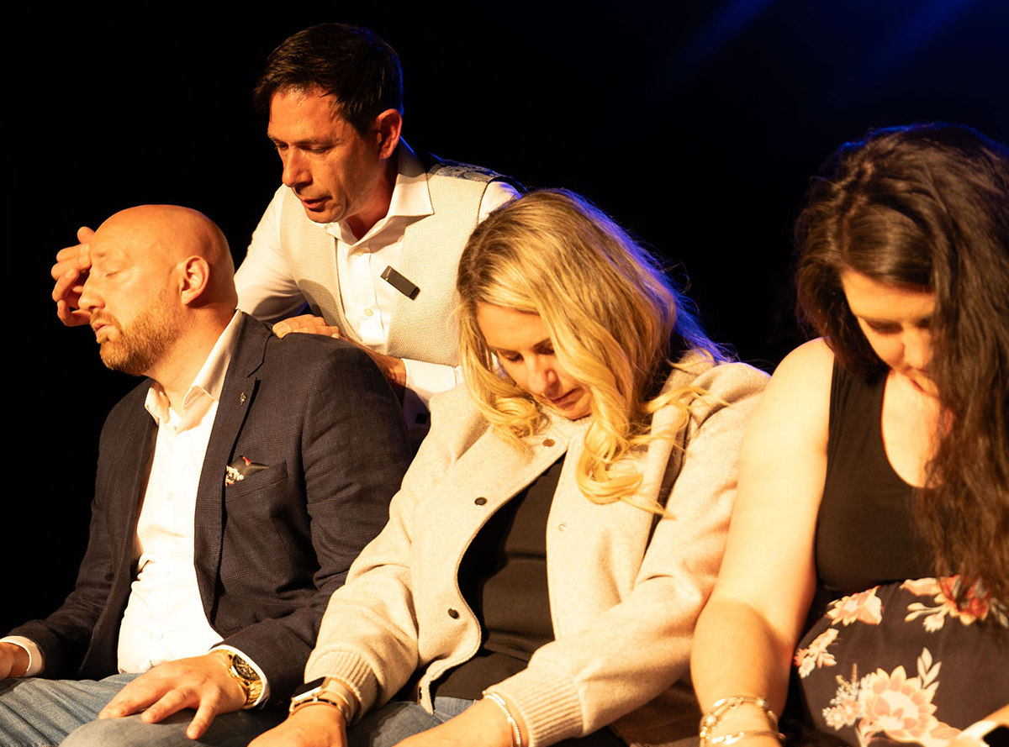
OVER 30 YEARS
English born Hypnotist, Poldark, first performed stage hypnosis in the early 1990’s.
Starting his expansive career, as then, the youngest Stage Hypnotist in Europe, at an age of just 21.
Over three decades on the international stage.
His career has seen him perform in many countries around the world including America, Spain, Germany, Ireland and the UK.

Slide 4


STAGE
CABARET
NEW
NEVER BEFORE SEEN
THEATRE
Poldark is a Master International Cabaret and Stage Hypnotist.
His production show can be seen in many theatre venues across the UK, as he is one of a handful of hypnotists that perform on an actual theatre stage.
The theatre and stage settings are where he feels most at home. Over the years he has scripted and moulded his show to suit most medium to large theatre venues.
‘Mind Mysteries’ intertwines hypnosis, mentalism and demonstrations of the minds’ potential using methods such as ESP, telepathy, sixth sense and psychometry, whilst adding in humour and wonder to the family friendly show.
With professional staffing who make up the team at the Poldark Show, sound and lighting technicians and stage / show coordinators, work alongside him to deliver a first class production show.
His stage performances have attracted media attention throughout the globe.
HEADLINE ACT
ON TOUR
Headlining shows throughout the UK with support performances from some of the countries most sought after Magicians and Entertainers.
The show has toured throughout the UK, bringing a fascinating experience to theatregoers around the country.

Slide 5
What to Expect from ‘The Poldark Show’
Imagine you're walking towards the venue with your friends. You're all chatting away excited to see Poldark the hypnotist, looking forward to being amazed and wondering who from your group will volunteer. It's a show you've been looking forward to; a show you're intrigued about and a show where you know you're going to wonder "how does he do that". You're about to experience something that you have never experienced before.
As you’re waiting in line, your best friend who has been talking about tonight for weeks, announces that she’s going to volunteer, she has always been curious about hypnosis and the sixth sense. There's heightened excitement and overheard words from other audience members... "I'm absolutely getting up on stage", "I've never been hypnotised before, I'd love to experience it", "we'll watch you from our seats and video you" and "did you watch the video of him, if it's anything like that, we're going to have an amazing time".
As you sit back and relax into your seat, the music starts, the intensity increases and the anticipation feels electric. The curtains open and Poldark appears and welcomes the audience into his mysterious world. As the music fades, he speaks to everyone and seizes your attention. Asking for volunteers to join him, your best friend takes a seat on the stage. Twenty or so volunteers are ready to be a part of something special.
Over the next 2 hours, Poldark expertly hypnotises his volunteers into a relaxing and meditative trance making them the stars of the show, as they entertain and mesmerise you, members of the audience. There are many moments of guaranteed laughter and engagement even for non-hypnotised audience members, as well as wonder and amazement. Your best friend believes she has won £5million on the lottery and runs over to celebrate with you telling you she’s going to spend it on shoes and a yacht; strangers get drunk on water at the imaginary bar and; you witness an unbelievable demonstration of telepathy between strangers.
Not only lots of comedy, there was so much more which is unexplainable; there’s genuine moments of disbelief and immersive altering perceptions, which you are struggling to understand and that last act, “wow, how does he do that”.
It’s a unique unforgettable performance; it’s mesmerising, it’s spellbinding, it’s a show that will literally blow your mind! My best friend and I agree that Poldark is a seasoned stage hypnotist and mind mysteries entertainer and if you're looking for a thrilling, live hypnosis performance, he's definitely worth checking out.
It’s more than a show, it’s an experience

Slide 6

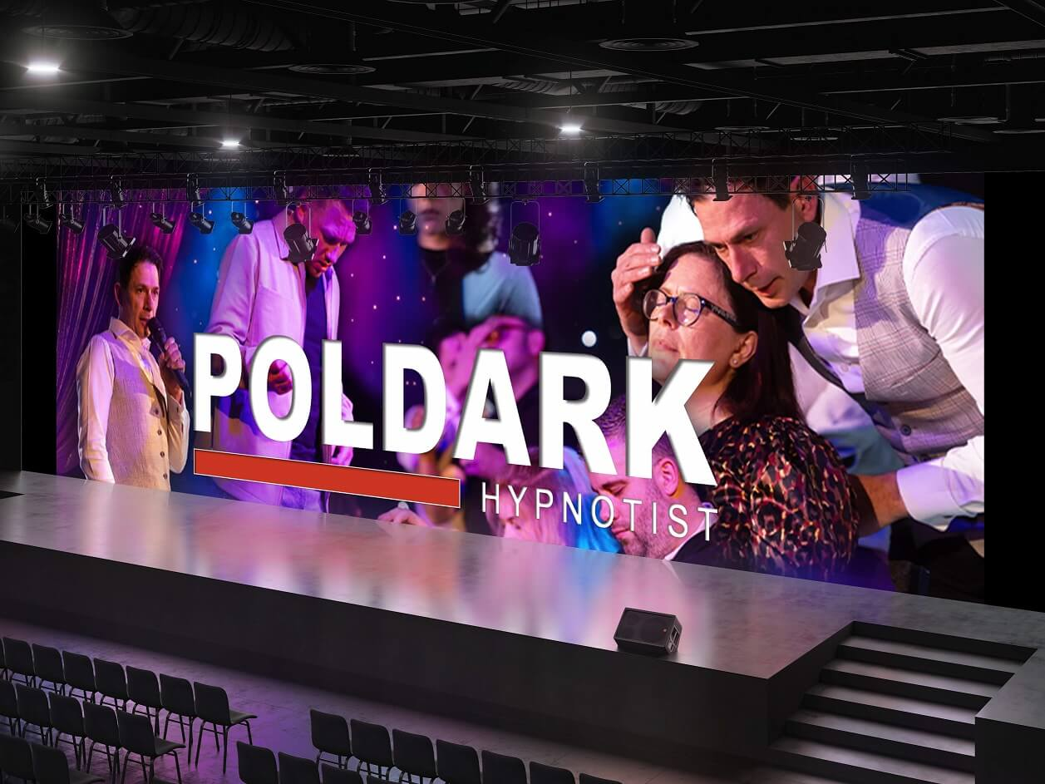

STYLE &
SHOW FORMAT
Known for blending hypnotic demonstrations of the mind with humor and audience participation, presented with a sense of class and respect for volunteers.
Described as mesmerising and very different from typical hypnotism shows and capable of transforming sceptics into believers with awe-inspiring performances.
Numerous reviewers praise his respectful and family friendly approach. Poldark avoids embarrassing volunteers, treats them and the audience with dignity and handles non-responders gracefully.
Demonstrated throughout his shows, he takes his volunteers into the audience, making the audience feel like they are part of the entertainment.
A mix of comedy and genuine amazement. Volunteers have an opportunity to experience demonstrations of the mind, including phenomena such as ESP, telepathy, psychometry and mentalism, all leading to a “mind blowing” finale.
Watch the Show Reel and see what can be experienced.
Alternatively, browse through some YouTube clips - youtube.com/@PoldarkShow

Slide 7
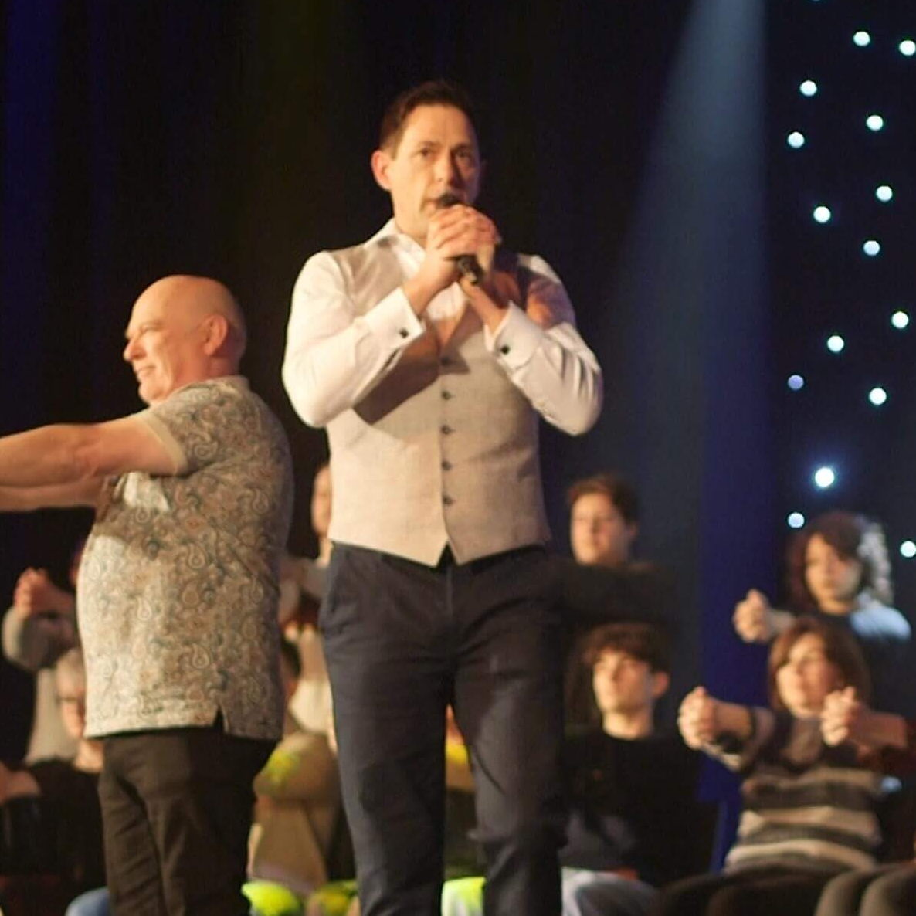
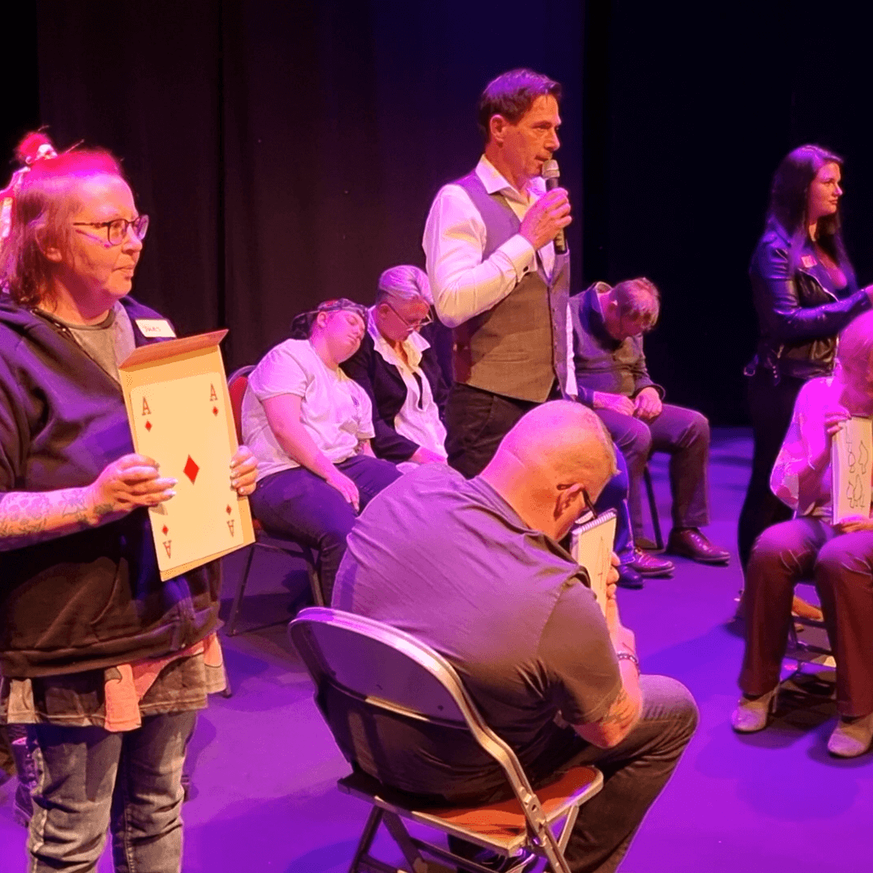
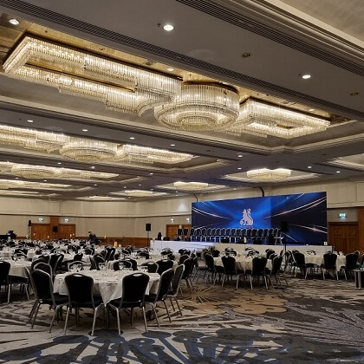
IT'S NOT JUST A STAGE SHOW
Entertaining is Poldarks' passion and performing for large audiences is where he feels most at home. Providing entertainment for corporate and private clients is just as important as for theatregoers.
THEATRE
PRIVATE FUNCTIONS
CORPORATE
The theatre setting is ideal; complete with professional staging, wings and curtains, stagehands, stair access and backstage support, as well as the essential elements of sound, which is crucial to the success of the show and lighting, which enhances the audience experience.
The Poldark Show is guaranteed to bring lots of laughter between family, friends, relatives and guests... no matter what the occasion.
Memories will be created, amazing stories will be shared and your event will be THE event which is spoken about and remembered for years to come.
When it comes to corporate entertainment, dare to be different. Whether it’s a gala dinner, awards ceremony or staff social event, Poldark delivers a powerful, immersive experience. Guaranteed to add a WOW factor and leave guests talking long after the event.

Slide 8
EXPERIENCE
POLDARK IN NUMBERS
Poldark is one of a small handful of hypnotists that have a natural born gift of hypnosis.
Entertaining audiences across the world; from the UK to the US, Ireland to Ibiza and many more countries in between.
Poldark has performed professionally and extensively over the past 30 years.
OVER 13,250
PEOPLE
HYPNOTISED
OVER
1,500
PERFORMANCES
34
YEARS
PERFORMING
BEING PROFESSIONAL
"It's the most important part of all."
EXPERIENCE
1991 – 2025
Stage Hypnotist
Stage - Cabaret – Theatre
2006 – 2025
Clinical Psychotherapist
Hypnotherapy
Psychotherapy
Psychoanalyst
CREDENTIALS
Member of HYPNOS 'British institute of Professional Stage Hypnotists'
Member of BCPSH 'British Council of Professional Stage Hypnotists’
Member of FESH ‘Federation of Ethical Stage Hypnotists’
ICPHC 'Institute of Clinical Psychotherapy Hypnotherapy Council'
Member of EQUITY
Liability Insurance
Full National and *Overseas Liability Cover (*request country list cover)
Full Equity Insurance Cover
Volunteers, who must be aged 18 or older, can refuse at any point to continue taking part in the performance
Poldark only hypnotises people that come on stage and volunteer, everybody else in the audience are spectators
Safety is paramount...
This is demonstrated throughout his shows, as he takes his volunteers into the audience, making the audience feel like they are part of the entertainment
Risk Assessment - an extensive performance Risk Assessment is provided at ALL of his performances, ensuring the public attending are kept in safe hands
PRS and PPL Licences - The Poldark Show is a full choreography production and with that, has extensive music tracks that are incorporated within the show, all of which have been registered with the Performing Rights Society (PRS) and Phonographic Performance Limited (PPL)
Show Rider - before any performance or rehearsal, a Show Rider is shared with the venue to facilitate with the venues' requirements

Slide 9
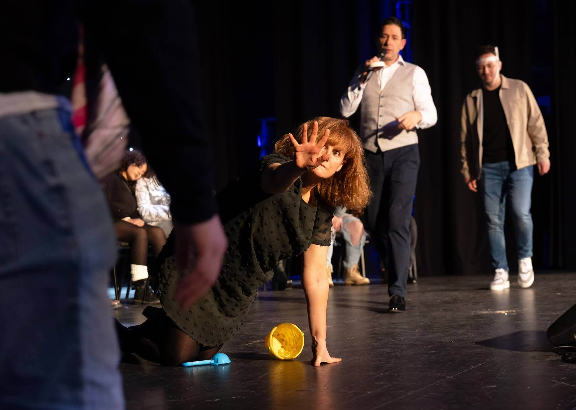


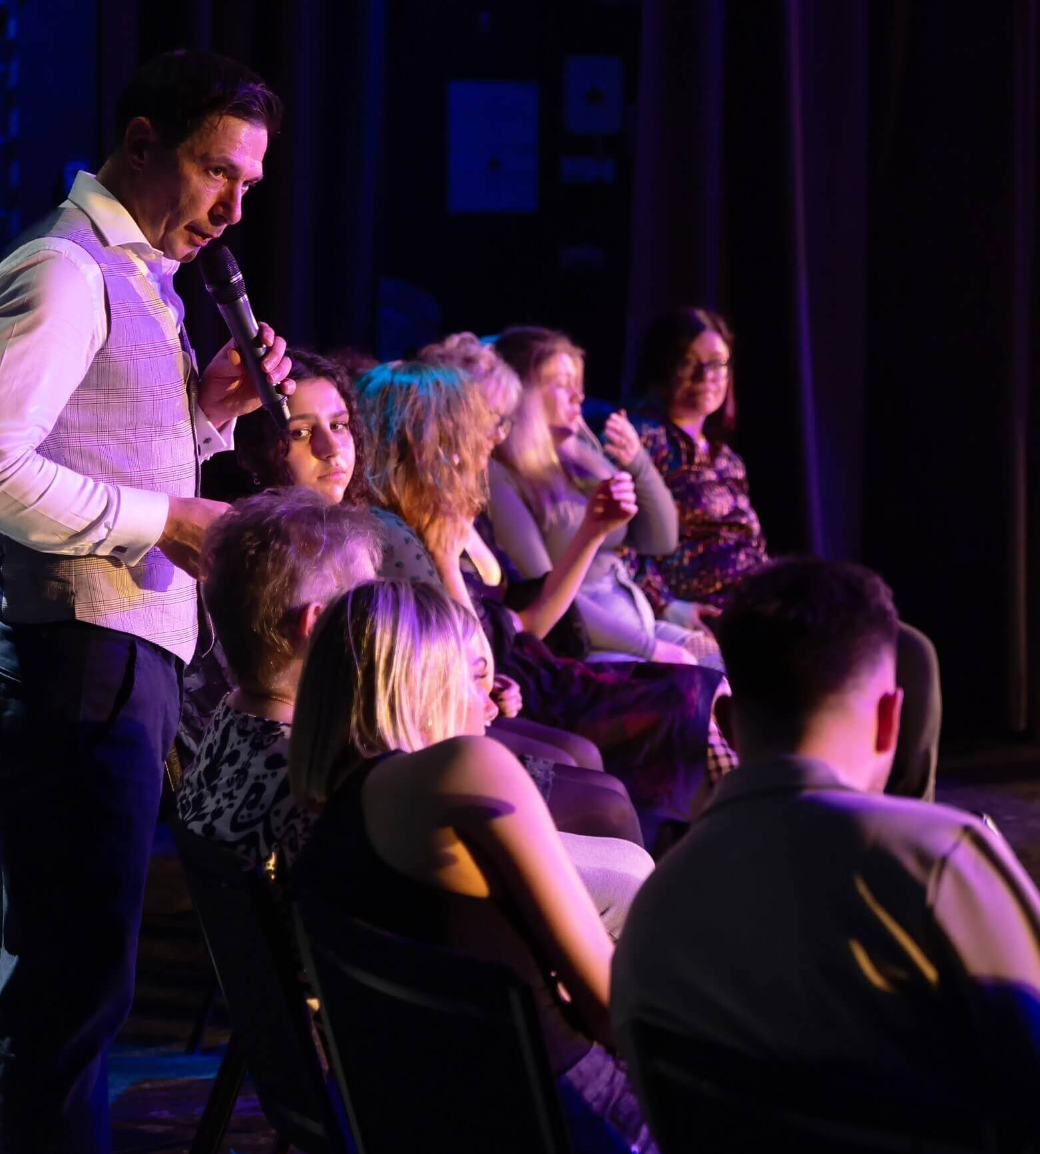
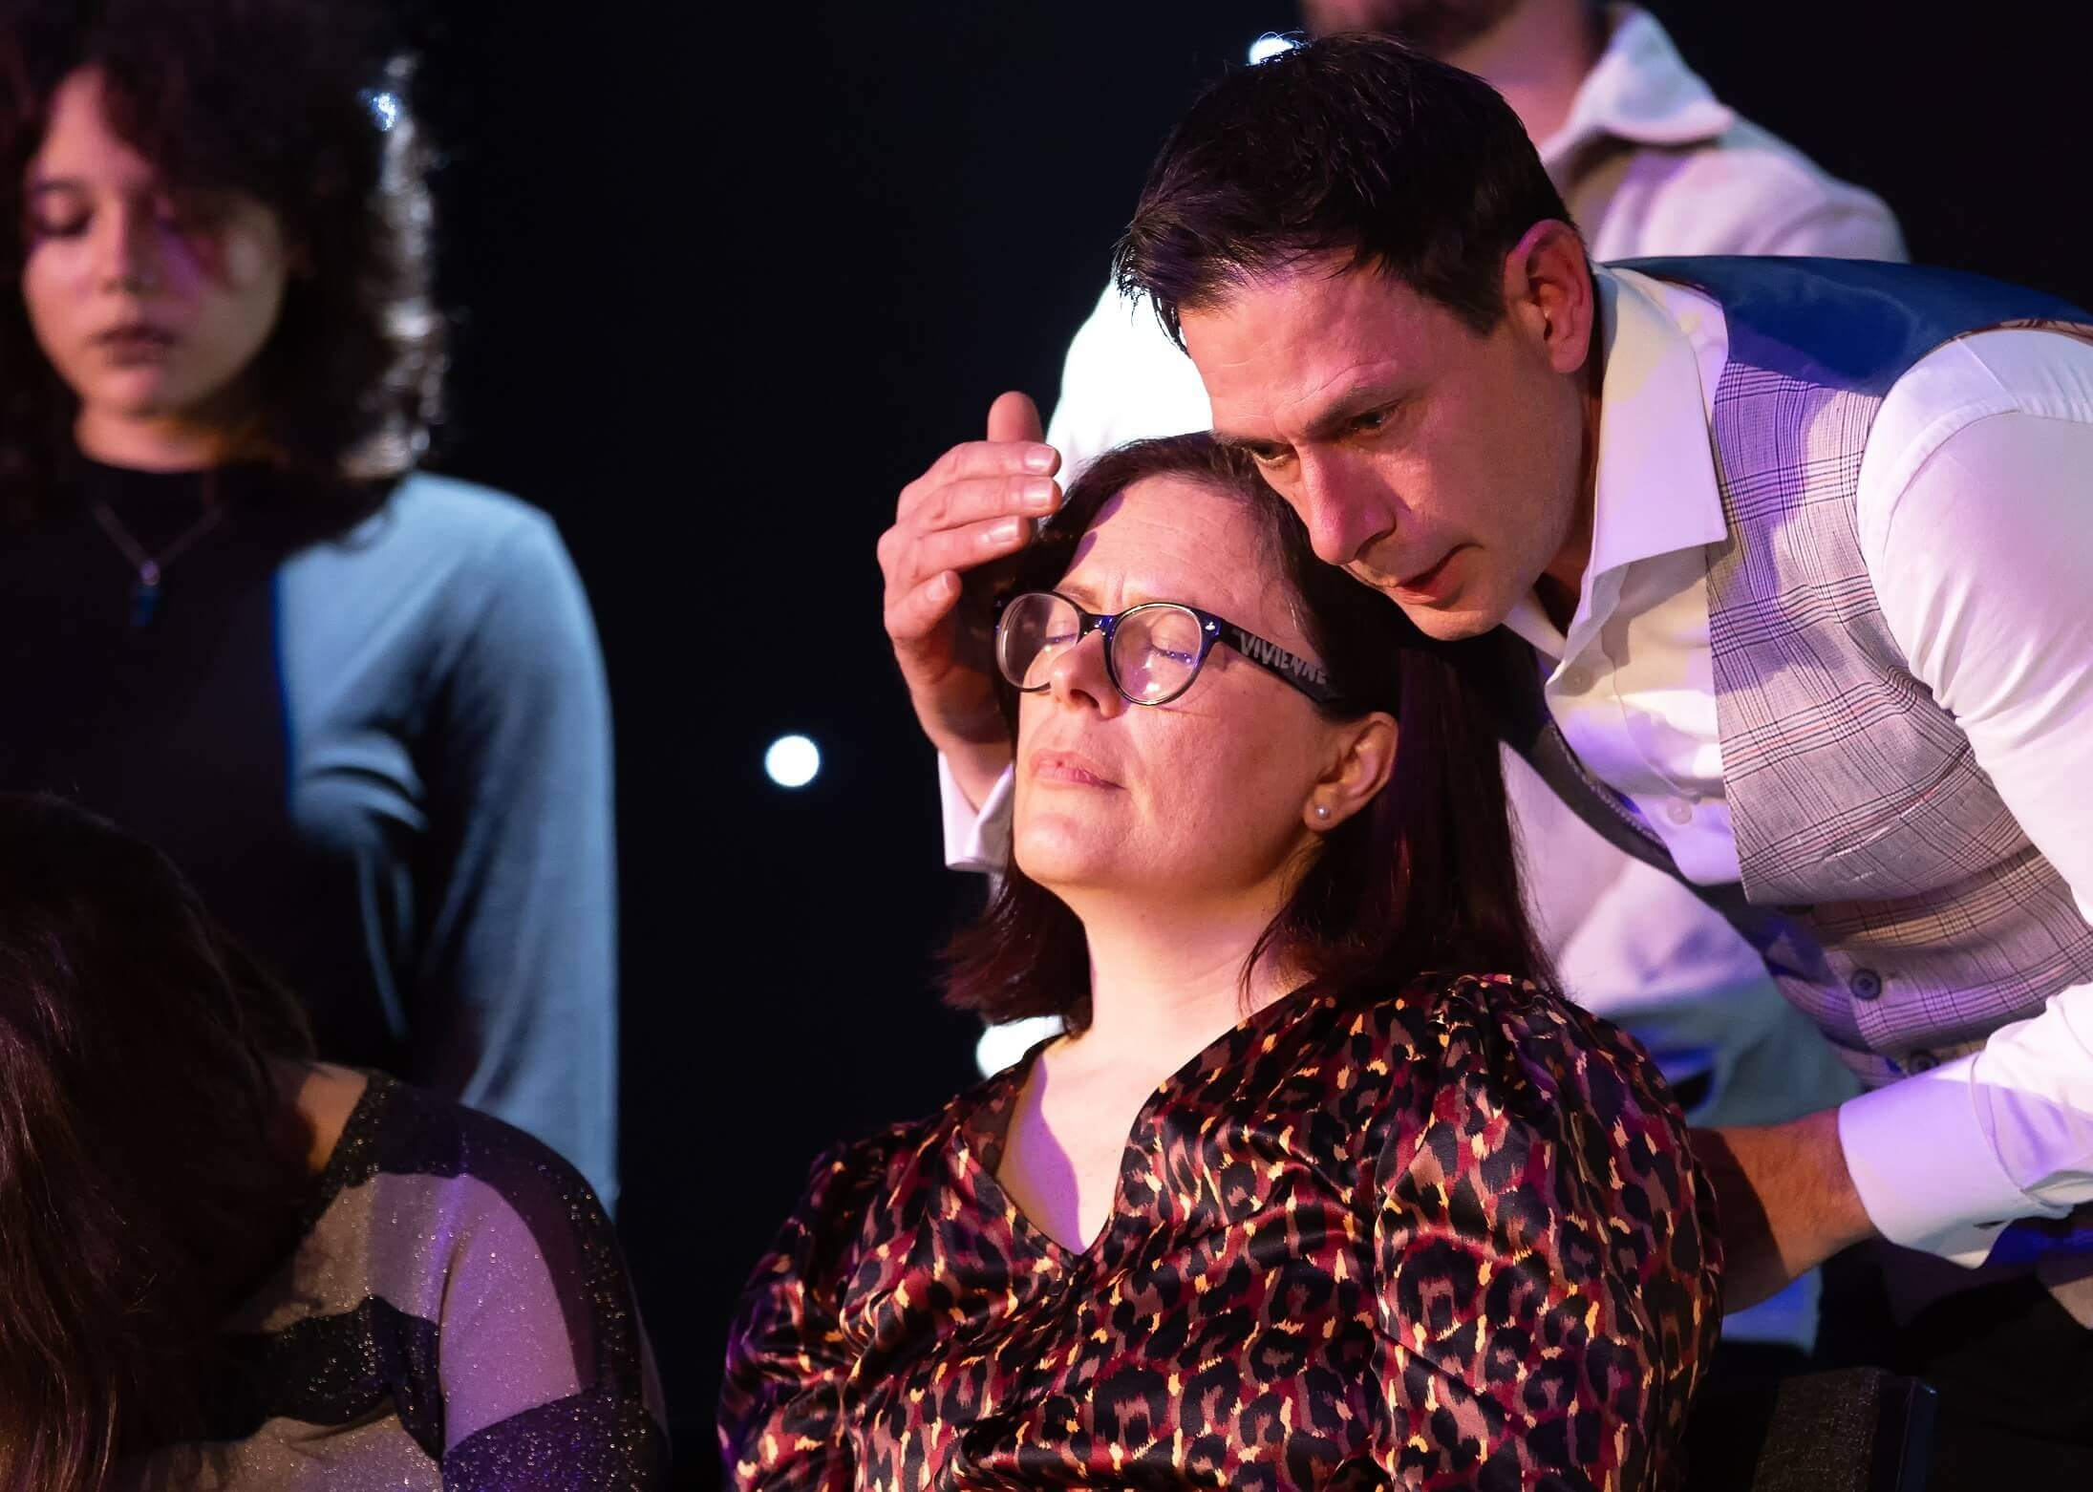
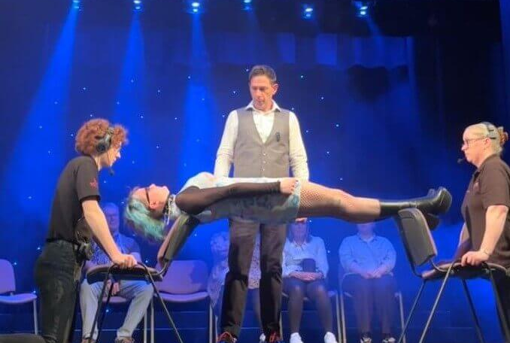
GALLERY
The media team work tirelessly to bring you some of the best footage from past shows.
Photographers and videographers get up close and personal, capturing every moment.

Slide 10
CHECK OUT THE
Customer satisfaction is the most important part of the whole production.
At The Poldark Show we are proud to have so many positive reviews from clients, customers and audience members alike.
Take a quick look at just a few we've put together.
REVIEWS
"Mind-blowing hypnosis with Poldark, honestly, words can’t do it justice.
It was one of the most incredible live performances I’ve ever seen. The reactions from the hypnotised volunteers were so real. I’m now officially a fan. Truly one of the best shows I’ve ever witnessed live.”
⭐️⭐️⭐️⭐️⭐️
"Fantastic show, it’s unbelievable and definitely a ‘must see’.
The ending was fantastic, if I hadn’t of seen it with my own eyes I wouldn’t have believed it. “
⭐️⭐️⭐️⭐️⭐️
"I was standing right there in front of him and I still can't figure out how he managed to get him to balance on the chairs.
There were no mirrors or props.
How is it done????“
⭐️⭐️⭐️⭐️⭐️
ADELE, REDDITCH
TERRY, LEICESTERSHIRE
ROB, RUGBY
"Completely mind blowing. Poldark is outstanding. I have seen hypnotist shows before but Poldark is the next level. I will definitely be travelling to watch this absolute showman again. The best show Belfast has had in years. A 5 Star show!"
⭐️⭐️⭐️⭐️⭐️
“Wow, what a night we had!
Poldark has such a natural talent and gave us a magnificent evening of wonder and real belly laughs. I was very sceptical but was utterly blown away…
I haven't been entertained like that for many years. Thank you Poldark. You really are amazing!”
⭐️⭐️⭐️⭐️⭐️
“Poldark delivered a highly entertaining performance… Throughout the show, Poldark had his volunteers engaged in hilarious antics, all while keeping his promise not to cause them undue embarrassment… for any sceptics in the audience, the finale… was convincing proof of the authenticity of his skills.”
⭐️⭐️⭐️⭐️
JOHN-MARK, BELFAST
CLAIRE, REDDITCH
LYNN - ONE4REVIEW

Slide 11
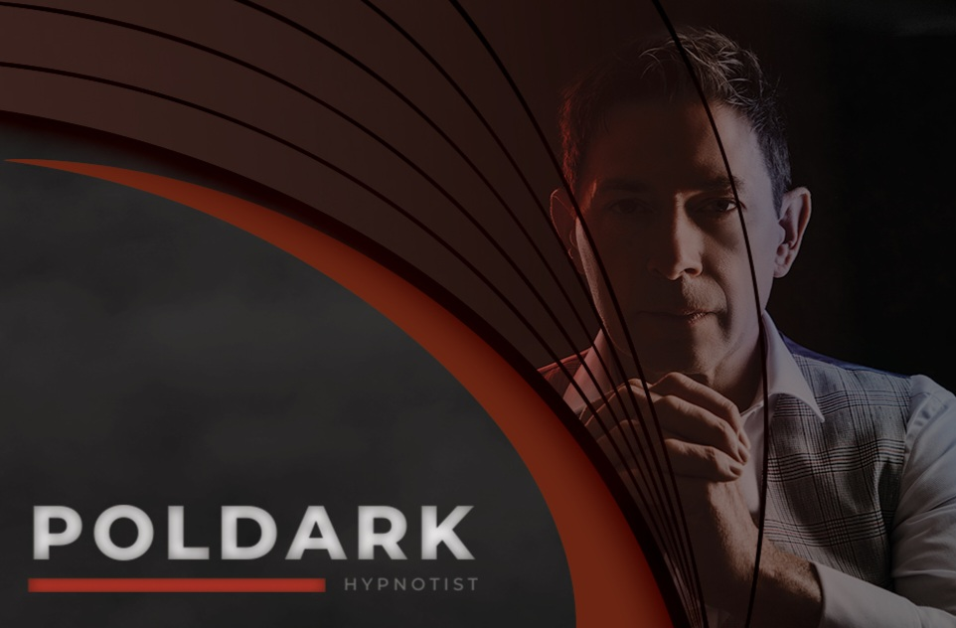
The Poldark hypnotism show is the closest that you will get to a performance of a scientific art that you just cannot explain. The power of the mind is explored throughout this entertaining show in the most insightful, amusing and educational way.
Audience volunteers are the stars of the show while working with expert hypnotist Poldark. No show is ever the same, and Poldark tells the audience, “Unlike magicians and comedians who work to scripts, I never know quite what lies ahead.”
Poldark talks you through the mysteries of the mind and explores ideomotor, ESP and much more. A slick and fast-paced show that worked through an interesting sequence at the start of the show with staging, lighting and sound all of high importance when Poldark starts hypnotising volunteers.
Volunteers make the free choice to appear on stage and Poldark follows a set of professional guidelines at all times. All audience members are treated with respect and they will not be allowed on stage if too young or intoxicated. Poldark takes all possible measures to avoid embarrassment to volunteers, who are referred to as the stars of the show.
The show is a decent length at around 1 hour 45 minutes and those who had been hypnotised were asked to describe the show and their experience before leaving the stage. All shared positive statements ranging from how relaxed they felt through to rested and surreal. When talking to one of the audience members who participated on stage after the show, they were feeling very positive and pleased that they had taken part.
As I was reviewing the show, it wouldn’t have made sense for me to volunteer to be hypnotised. However, while I was of the mindset pre-show that I would not want to be hypnotised myself, I have changed my opinion and I am now open to the idea, as Poldark and the team certainly want all to have a unique experience. Without doubt any volunteer can feel confident that they will be treated to a unique experience and star in the show. Where else could you do that?
Poldark has no easy task presenting the show while working with the audience members in a hypnotic state. Quite the showman and a very well-rehearsed and professional show. Staging, lighting, and sound were all excellent.
Thank you to Poldark and his team for a fantastic night out.
I cannot recommend this show more highly and you will have a very entertaining night out.
MAGIC SEATS
Martin Brophy, Author. Magic Seats, June 2025
THE POLDARK SHOW 2025
⭐️⭐️⭐️⭐️⭐️

Slide 12
The beautiful venue choice and staging perfectly sets the scene for the style of The Poldark Show—Stage Hypnotist. The audience enters a church hall to find a velvet draped stage, and the sense of classy grandeur is a constant throughout the show.
Hypnotist Poldark is clearly a master of the craft, balancing respect for his participants with showmanship and entertainment for the offstage members of the audience.
Poldark’s brand of hypnosis is notable at this Fringe for its calming, meditative qualities in a field that currently seems to favour sharp, loud noises as a methodology. The Poldark version is more pleasant on the audience ear, even providing a relaxing environment for those who did not put themselves forward to be hypnotised. No one method of hypnotism will work on everyone, but at the reviewed show Poldark had a very respectable success rate, that gave him ample supply of hypnotised individuals for his demonstrations.
There is a gently comedic element to The Poldark Show, in a respectful and family friendly way. The hypnotised participants are not asked to do anything embarrassing. His final hypnotic demonstration is less for comedic effect and more just for the wow factor.
Even those who have seen a wide variety of other hypnotism shows are unlikely to have seen anything even remotely close to this. Poldark has a kind stage presence, and at the reviewed show some who did not manage to get hypnotised or were awoken from that state during the performance even played along just to try to help him out. However, ever the professional, Poldark spotted them quickly and found opportune moments to quickly ensure that they were okay and invite them to return to the rest of the audience.
The hypnotism takes the majority of the show’s run time, but Poldark does still take a moment to get the whole audience involved in a warm up imaginative exercise. It may start similar to an exercise often used in this kind of show, but once again Poldark demonstrates his unusual take on stage hypnotism—it’s actually a completely different exercise to what the audience probably anticipates.
The Poldark Show is without a doubt the place to be this Fringe for a pleasant hypnotic experience, whether as an onstage participant or a curious onlooker. Unfortunately the reviewed show was the final one of this Fringe, but Poldark will be heading out on tour, and will hopefully return to Edinburgh someday. Fans of being hypnotised or watching hypnotism are advised to look him up.
WORLD MAGIC REVIEW
Hannah S, Author. World Magic Review, 2024
THE POLDARK SHOW: STAGE HYPNOTIST
⭐️⭐️⭐️⭐️⭐️

Slide 13











CONTACT US
FACEBOOK
hello@poldarkshow.com
facebook.com/poldarkshow
CHECK US OUT
LINKEDIN
www.poldarkshow.com
linkedin.com/company/poldarkshow
LOCATION
INSTAGRAM
Warwickshire, UK
instagram.com/poldarkshow
TIKTOK
TikTok.com/@poldarkshow
YOUTUBE
Download as a File or view as a Flipbook
youtube.com/@PoldarkShow
© 2025 THE POLDARK SHOW All Rights Reserved.

