Slide 1
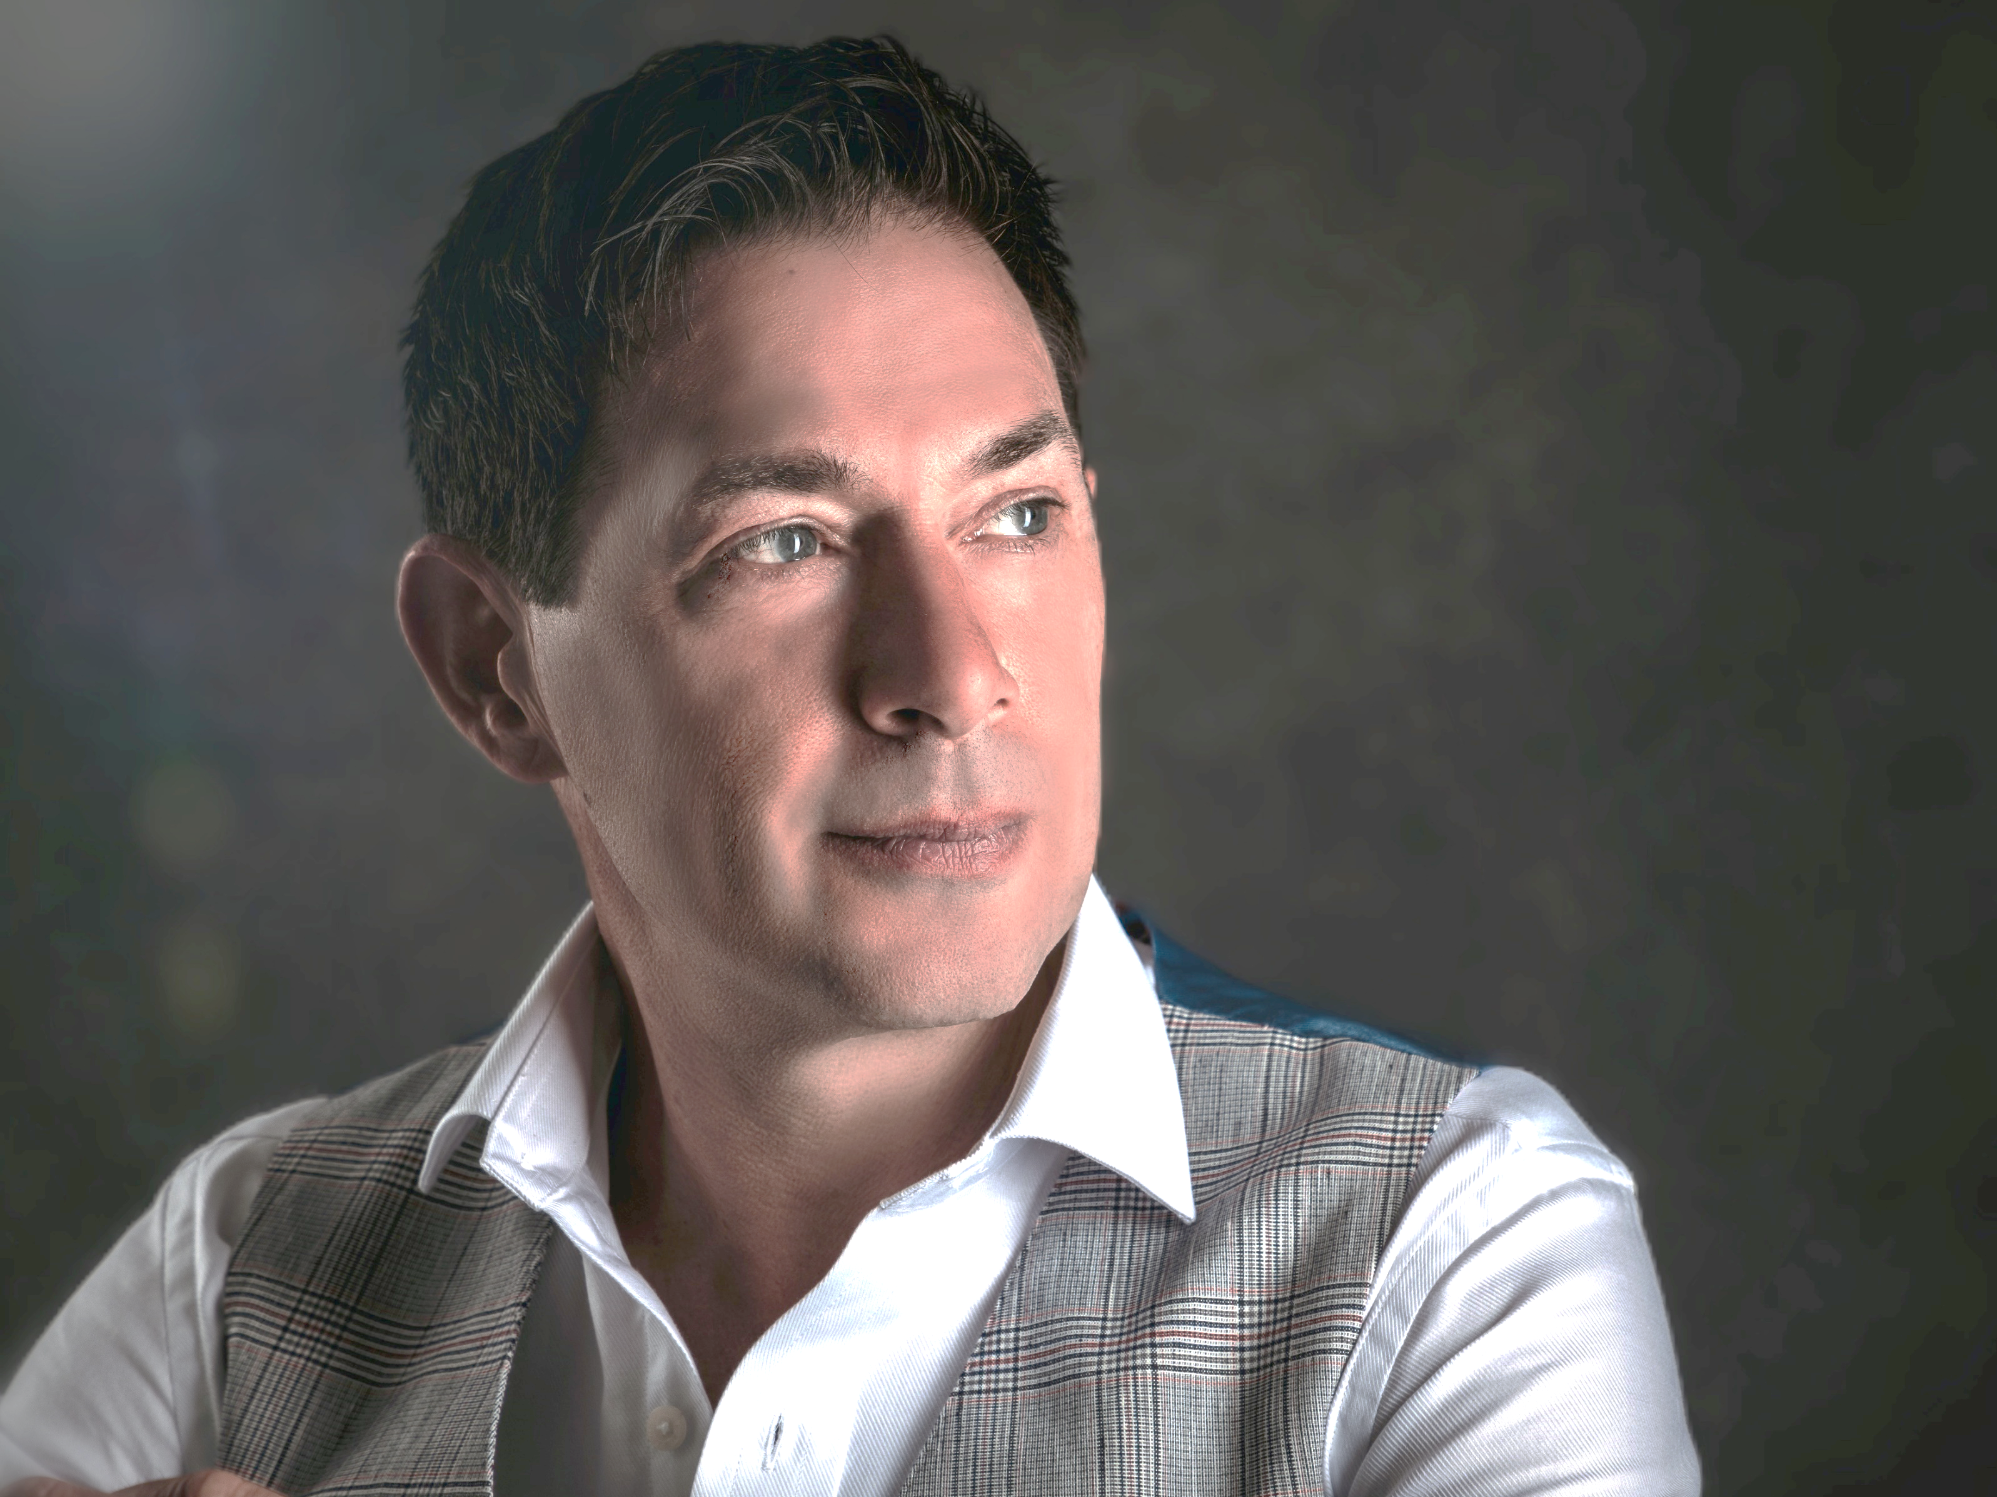
POLDARK
INTERNATIONAL HYPNOTIST

Slide 2
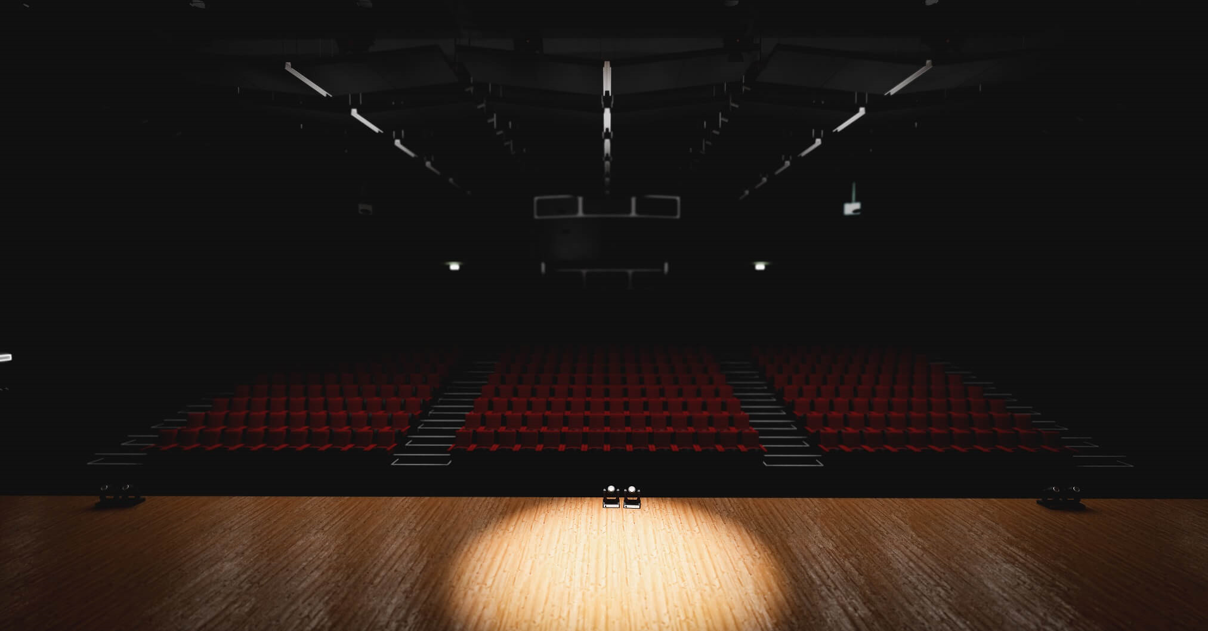






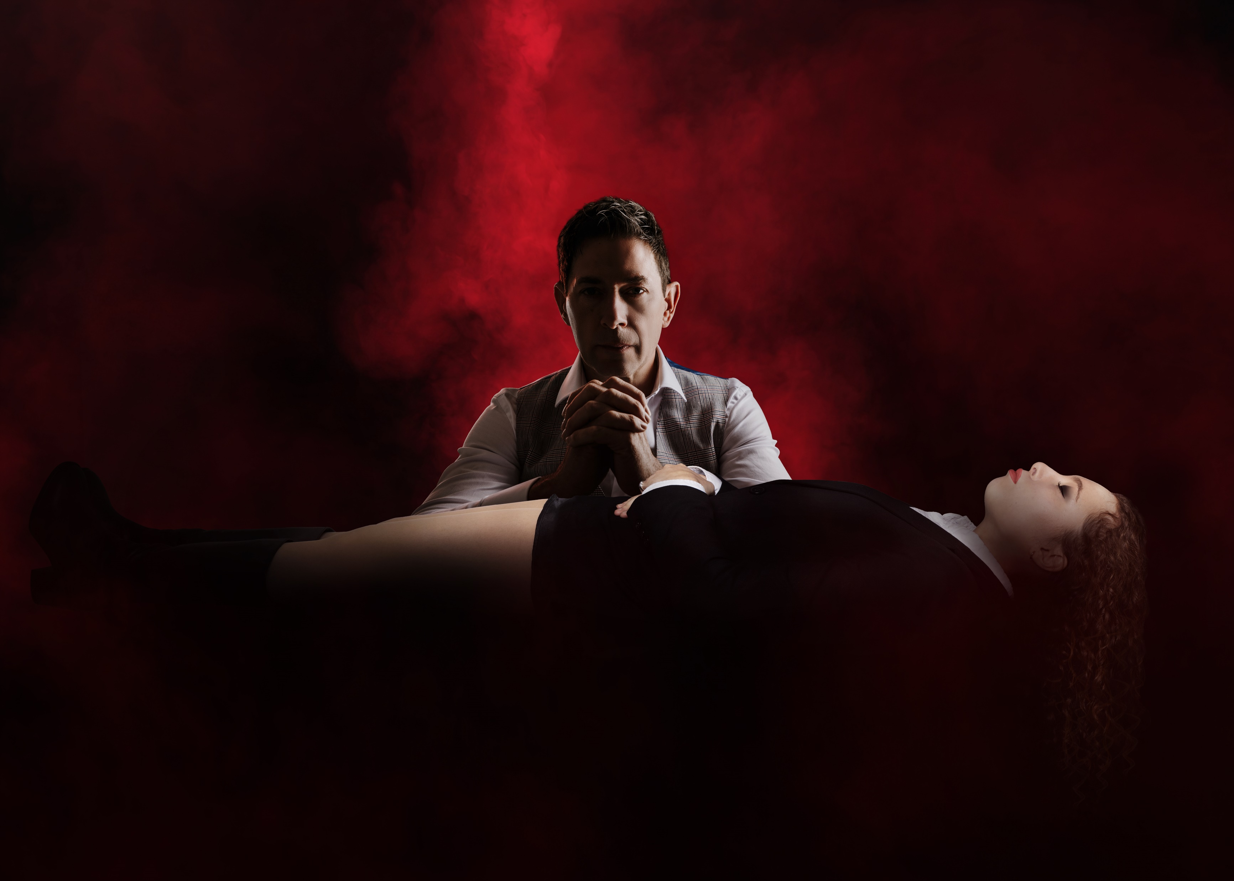
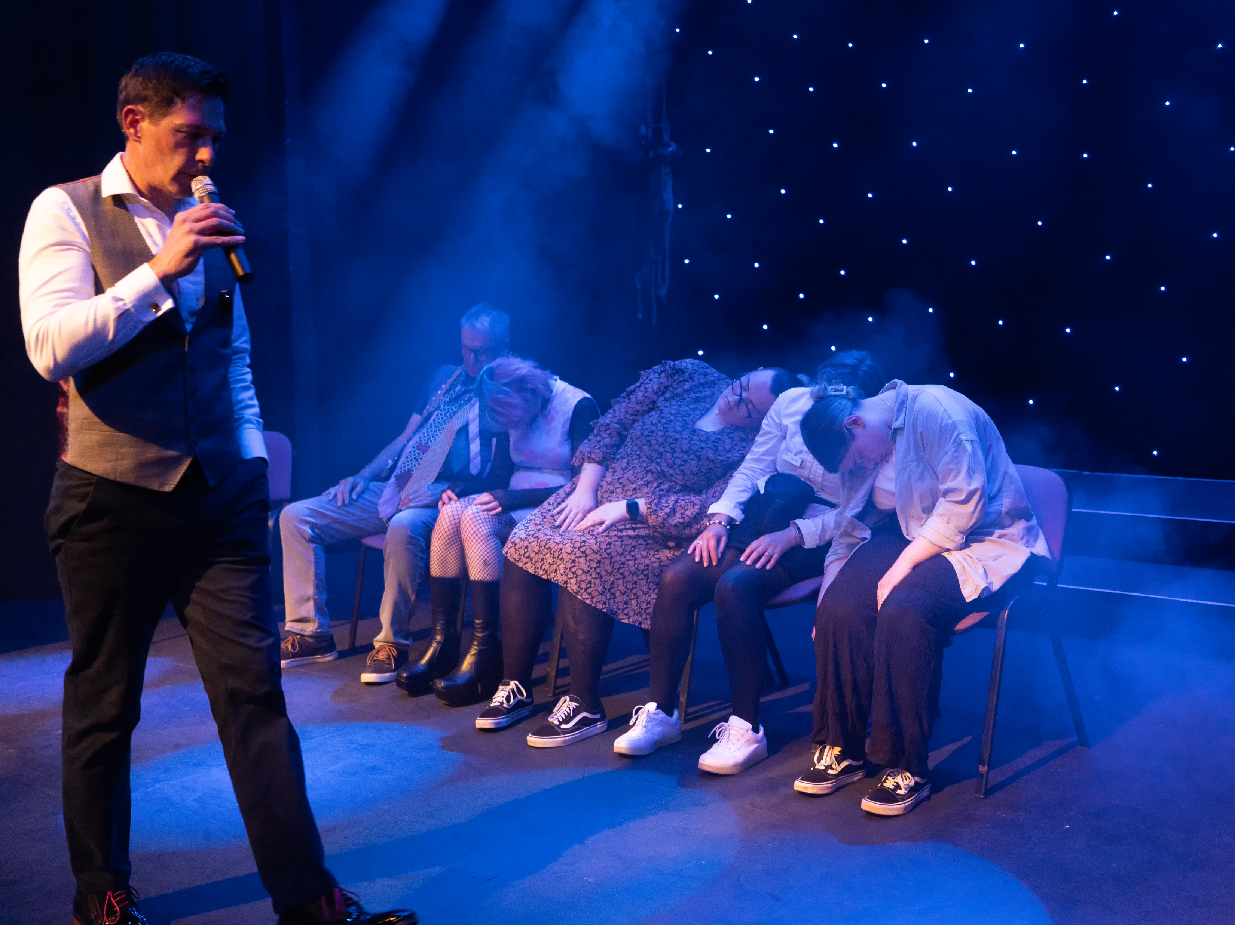
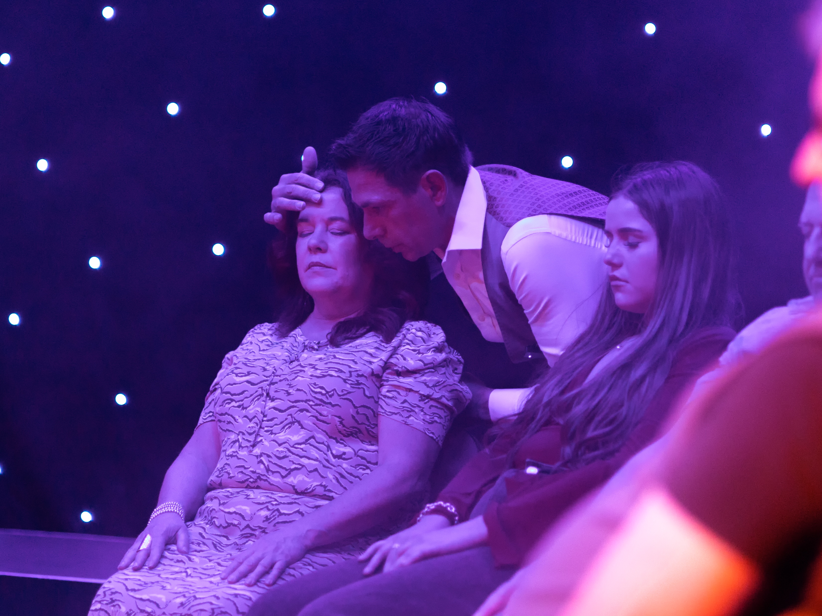
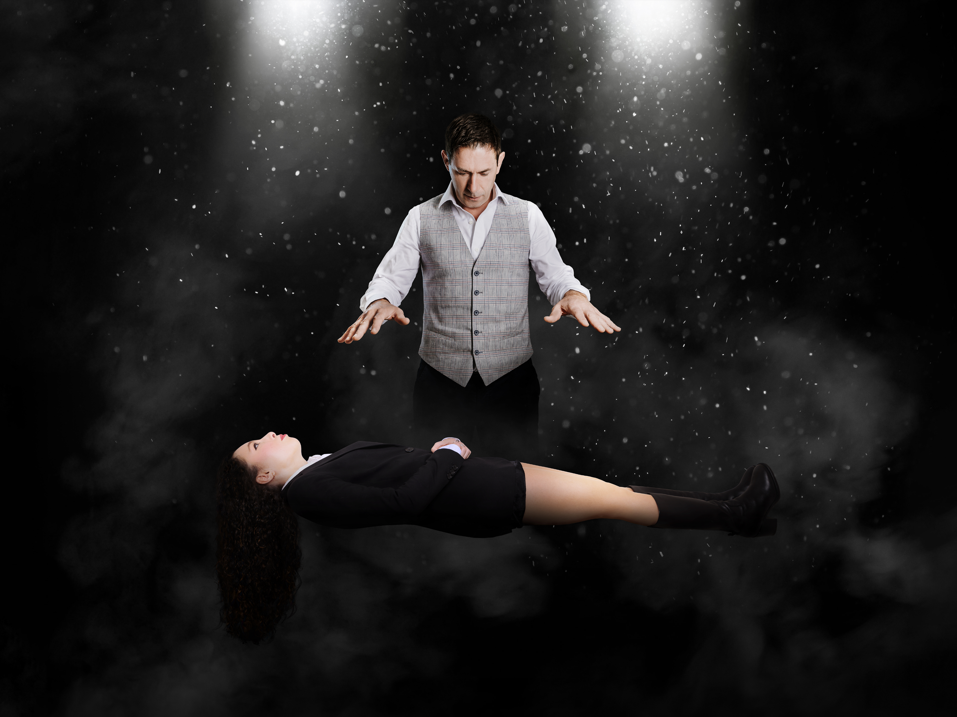
With an extremely interesting back story, Poldark is privileged to be part of a small unique handful of 'naturally' gifted hypnotists. Today, he is the only remaining one.
A master hypnotist with over 30 years’ of experience traveling the world, performing to corporate, private and public clients. Poldark is the hypnotist to see for powerful, mind-blowing mesmerising performances, with demonstrations of hypnotic phenomena and the power of the mind. Audiences leave entertained, amazed and wanting more.
Poldark has the ability to expertly navigate even the most complex of audience interactions, making for an unforgettable and unique experience, time after time.

Slide 3
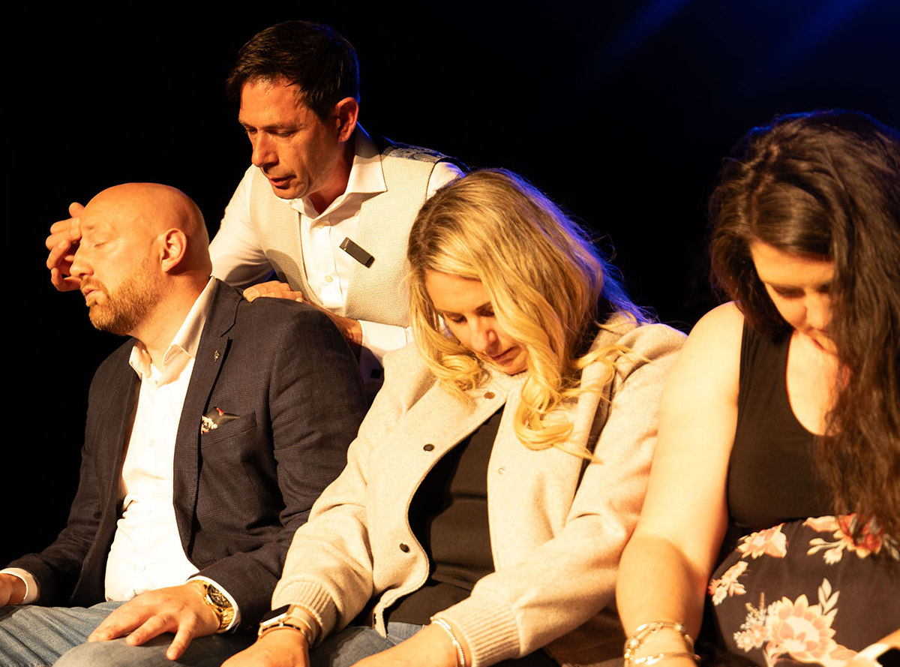
OVER 30 YEARS
English born Hypnotist, Poldark, first performed stage hypnosis in the early 1990’s.
Starting his expansive career, as then, the youngest Stage Hypnotist in Europe, at an age of just 21.
His career has seen him perform in many countries around the world including America, Spain, Germany, Ireland and the UK.

Slide 4

STAGE.
CABARET.
Poldark is a Master International Cabaret and Stage Hypnotist.
His production show can be seen in many theatre venues across the UK, as he is one of a handful of hypnotists that perform on an actual theatre stage.
The theatre and stage settings are where he feels most at home. Over the years he has scripted and moulded his show to suit most medium to large theatre venues.
With professional staffing who make up the team at the Poldark Show, sound and lighting technicians and stage /show coordinators, work alongside him to deliver a first class production show.
His stage performances have attracted media attention throughout the globe.
THEATRE.
HEADLINE ACT
ON TOUR
Headlining shows throughout the UK with support performances from some of the countries most sought after Magicians and Entertainers.
The show has toured throughout the UK, bringing a fascinating experience to theatregoers around the country.

Slide 5

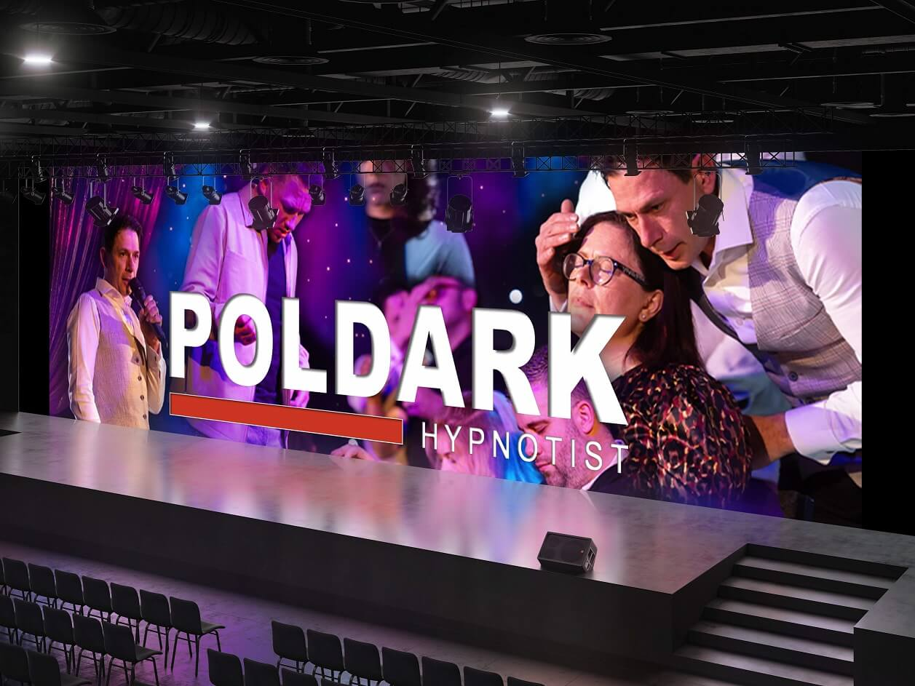

He is privileged to be part of a small unique handful of 'naturally' gifted hypnotists.
This is demonstrated throughout his shows, as he takes his volunteers into the audience, making the audience feel like they are part of the entertainment.
Watch the Show Reel and see what can be experienced.
Alternatively, browse through some YouTube clips...
youtube.com/@PoldarkShow

Slide 6
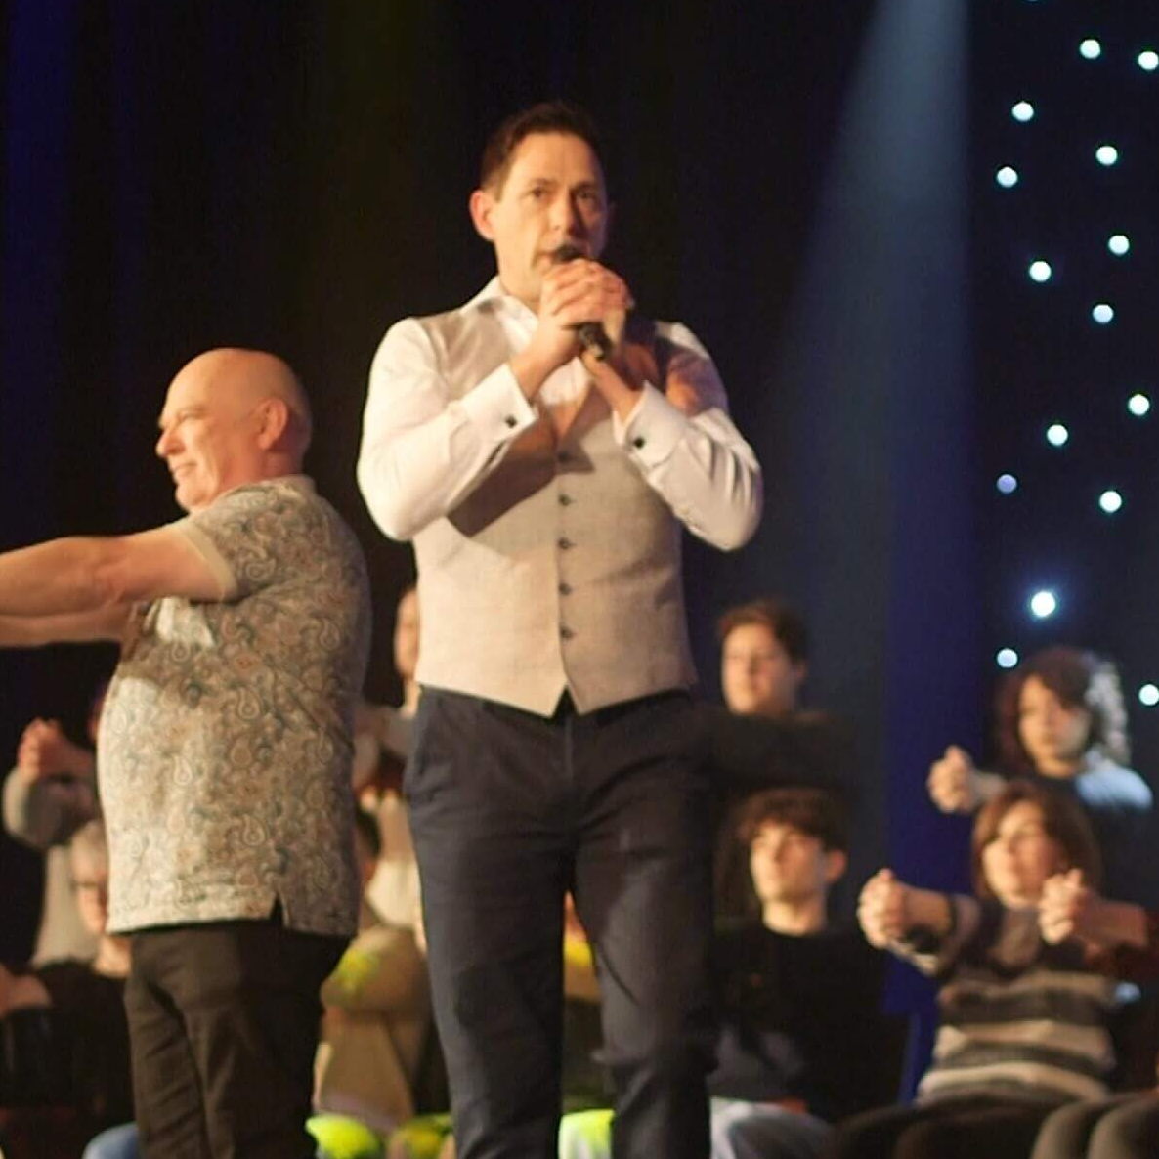
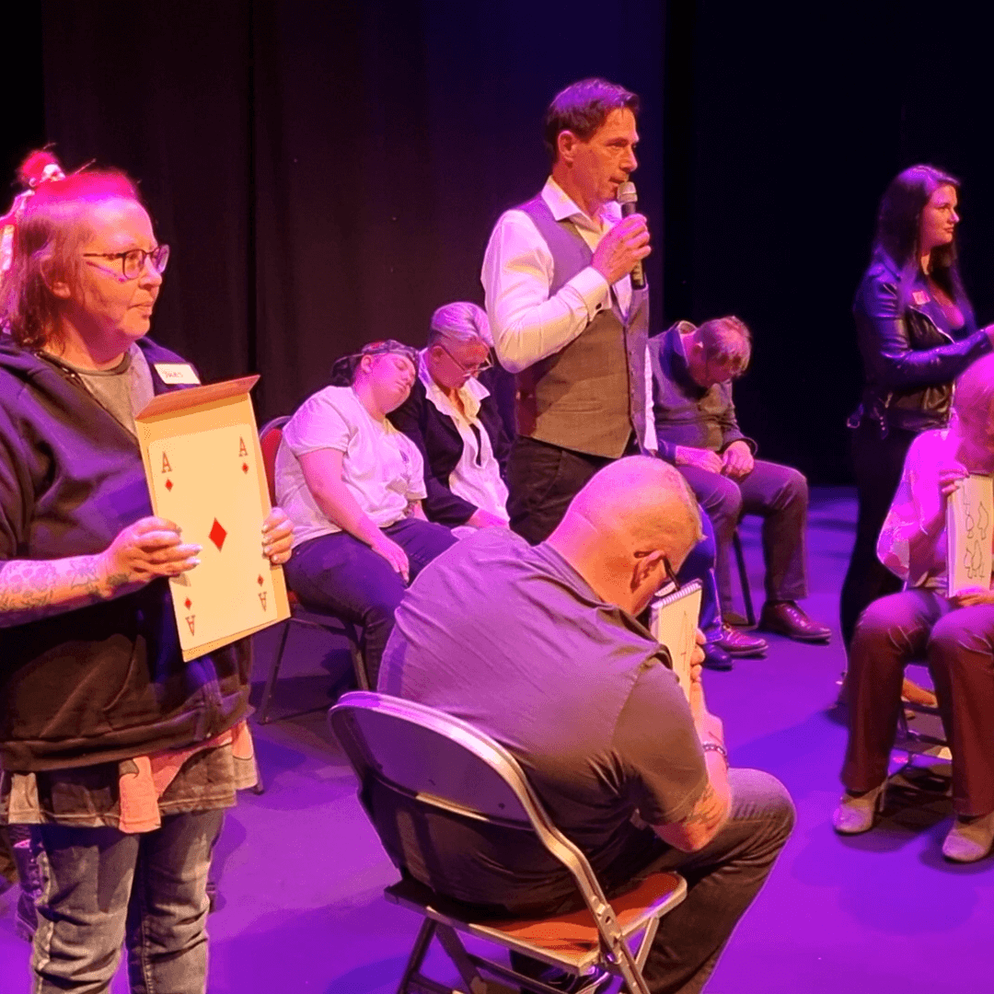
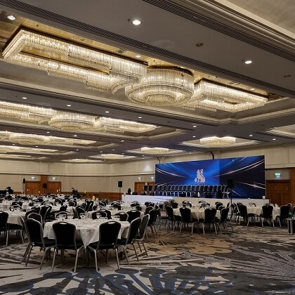
IT'S NOT JUST A STAGE SHOW
Entertaining is Poldarks' passion and performing for large audiences is where he feels most at home. Providing entertainment for corporate and private clients is just as important as for theatregoers.
THEATRE
PRIVATE FUNCTIONS
CORPORATE
The theatre setting is ideal; complete with professional staging, wings and curtains, stagehands, stair access and backstage support, as well as the essential elements of sound, which is crucial to the success of the show and lighting, which enhances the audience experience.
The Poldark Show is guaranteed to bring lots of laughter between family, friends, relatives and guests... no matter what the occasion.
Memories will be created, amazing stories will be shared and your event will be THE event which is spoken about and remembered for years to come.
When it comes to corporate entertainment, dare to be different. Whether it’s a gala dinner, awards ceremony or staff social event, Poldark delivers a powerful, immersive experience. Guaranteed to add a WOW factor and leave guests talking long after the event.

Slide 7
EXPERIENCE
POLDARK IN NUMBERS
Poldark is one of a small handful of hypnotists that have a natural born gift of hypnosis.
Entertaining audiences across the world; from the UK to the US, Ireland to Ibiza and many more countries in between.
Poldark has performed professionally and extensively over\ the past 30 years.
OVER 13,250
PEOPLE
HYPNOTISED
OVER
1,500
PERFORMANCES
34
YEARS
PERFORMING
BEING PROFESSIONAL
"It's the most important part of all."
EXPERIENCE
1991 – 2025
Stage Hypnotist
Stage - Cabaret – Theatre
2006 – 2025
Clinical Psychotherapist
Hypnotherapy
Psychotherapy
Psychoanalist
CREDENTIALS
Member of HYPNOS 'British institute of Professional Stage Hypnotists'
Member of BCPSH 'British Council of Professional Stage Hypnotists'
ICPHC 'Institute of Clinical Psychotherapy Hypnotherapy Council'
Member of EQUITY
Liability Insurance -
Full National and *Overseas Liability Cover (*request country list cover)
Full Equity Insurance Cover
Volunteers, who must be aged 18 or older, can refuse at any point to continue taking part in the performance
Poldark only hypnotises people that come on stage and volunteer, everybody else in the audience are spectators
Safety is paramount...
This is demonstrated throughout his shows, as he takes his volunteers into the audience, making the audience feel like they are part of the entertainment
Risk Assessment - an extensive performance Risk Assessment is provided at ALL of his performances, ensuring the public attending are kept in safe hands
PRS and PPL Licences - The Poldark Show is a full choreography production and with that, has extensive music tracks that are incorporated within the show, all of which have been registered with the Performing Rights Society (PRS) and Phonographic Performance Limited (PPL)
Show Rider - before any performance or rehearsal, a Show Rider is shared with the venue to facilitate with the venues' requirements

Slide 8
What to Expect from ‘The Poldark Show’
Imagine you're walking towards the venue with your friends. You're all chatting away excited to see Poldark the hypnotist, looking forward to being amazed and wondering who from your group will volunteer. It's a show you've been looking forward to; a show you're intrigued about and a show where you know you're going to wonder "how does he do that". You're about to experience something that you have never experienced before.
As you’re waiting in line, your best friend who has been talking about tonight for weeks, announces that she’s going to volunteer, she has always been curious about hypnosis. There's heightened excitement and overheard words from other audience members... "I'm absolutely getting up on stage", "I've never been hypnotised before, I'd love to experience it", "we'll watch you from our seats and video you" and "did you watch the video of him, if it's anything like that, we're going to have an amazing time".
As you sit back and relax into your seat, the music starts, the intensity increases and the anticipation feels electric. The curtains open and Poldark, International Cabaret and Master Stage Hypnotist appears and welcomes the audience into his hypnotic world. As the music fades, he speaks to everyone and seizes your attention. Asking for volunteers to join him, your best friend takes a seat on the stage. Twenty or so volunteers are ready to be a part of something special.
Over the next 2 hours, Poldark expertly hypnotises his volunteers into a trance making them the stars of the show, as they entertain you, members of the audience. There are many moments of laughter; your best friend frantically searches for an imaginary puppy that has escaped from her arms convinced it’s hiding under chairs or behind curtains; she also believes she has won £5million on the lottery and runs over to celebrate with you telling you she’s going to spend it on shoes and a yacht; and strangers get drunk on water at the imaginary bar.
Not only lots of comedy, there was so much more which is unexplainable; there’s genuine moments of amazement and wonder, which you are struggling to understand and that last act, “wow, how does he do that”.
It’s a unique unforgettable performance; it’s mesmerising, it’s spellbinding, it’s a show that will literally blow your mind!

Slide 9
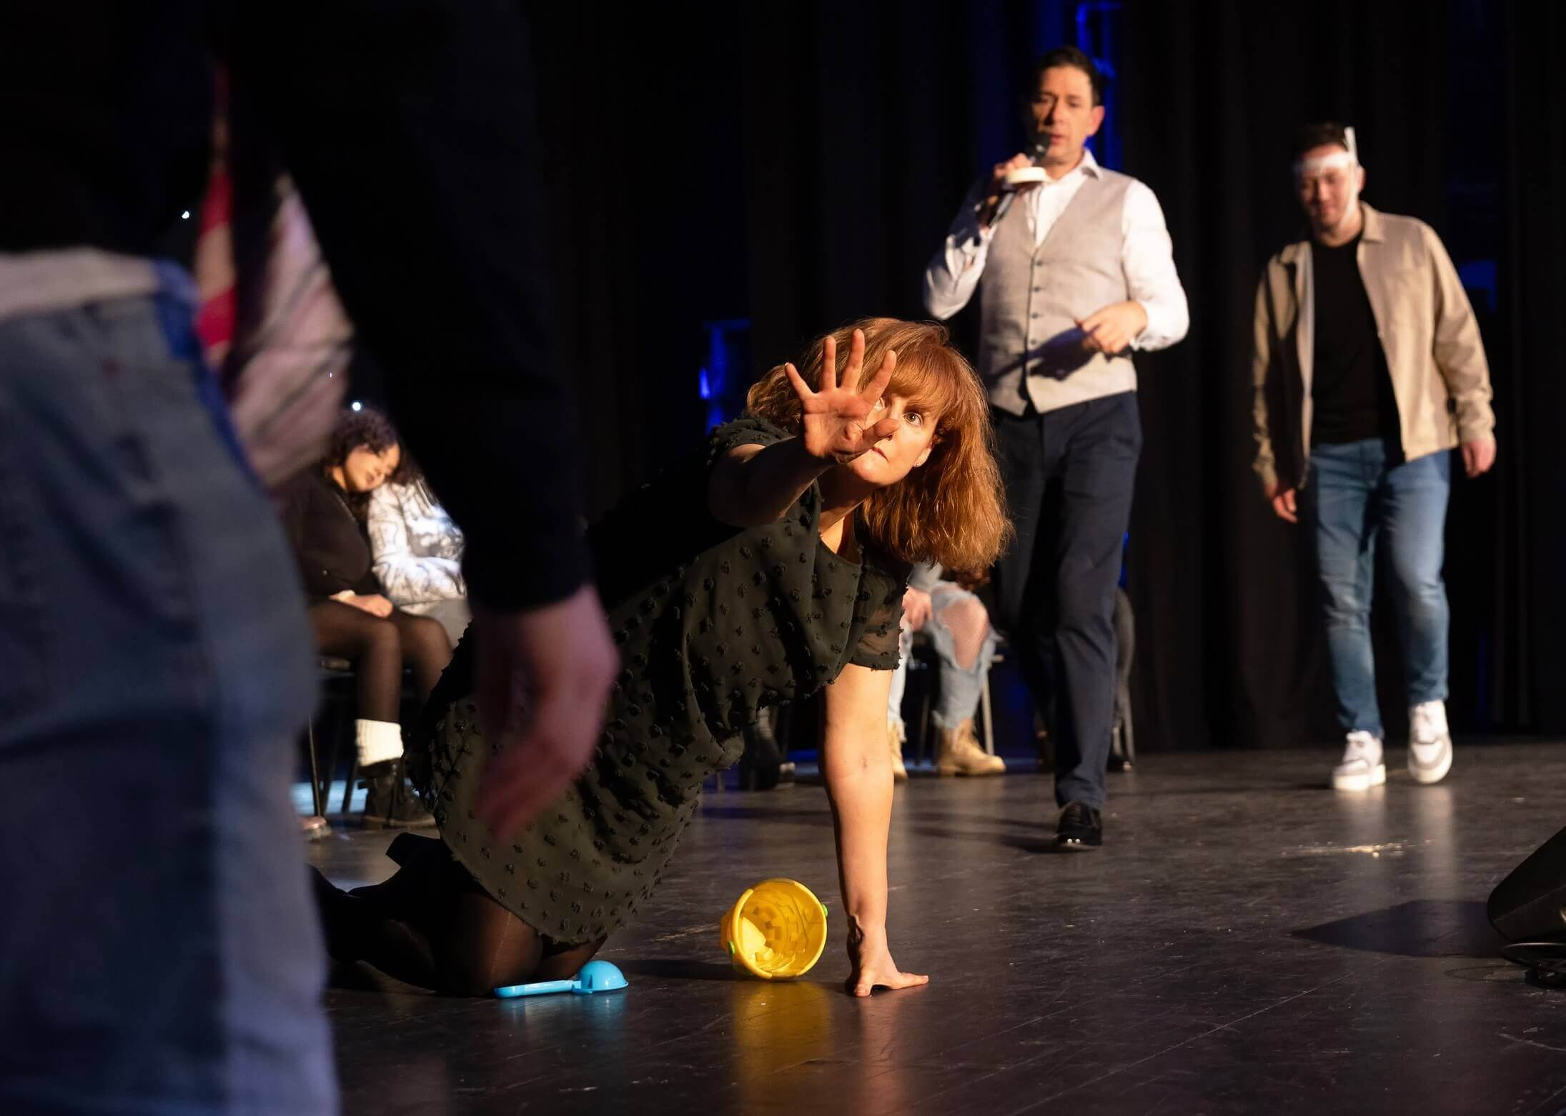
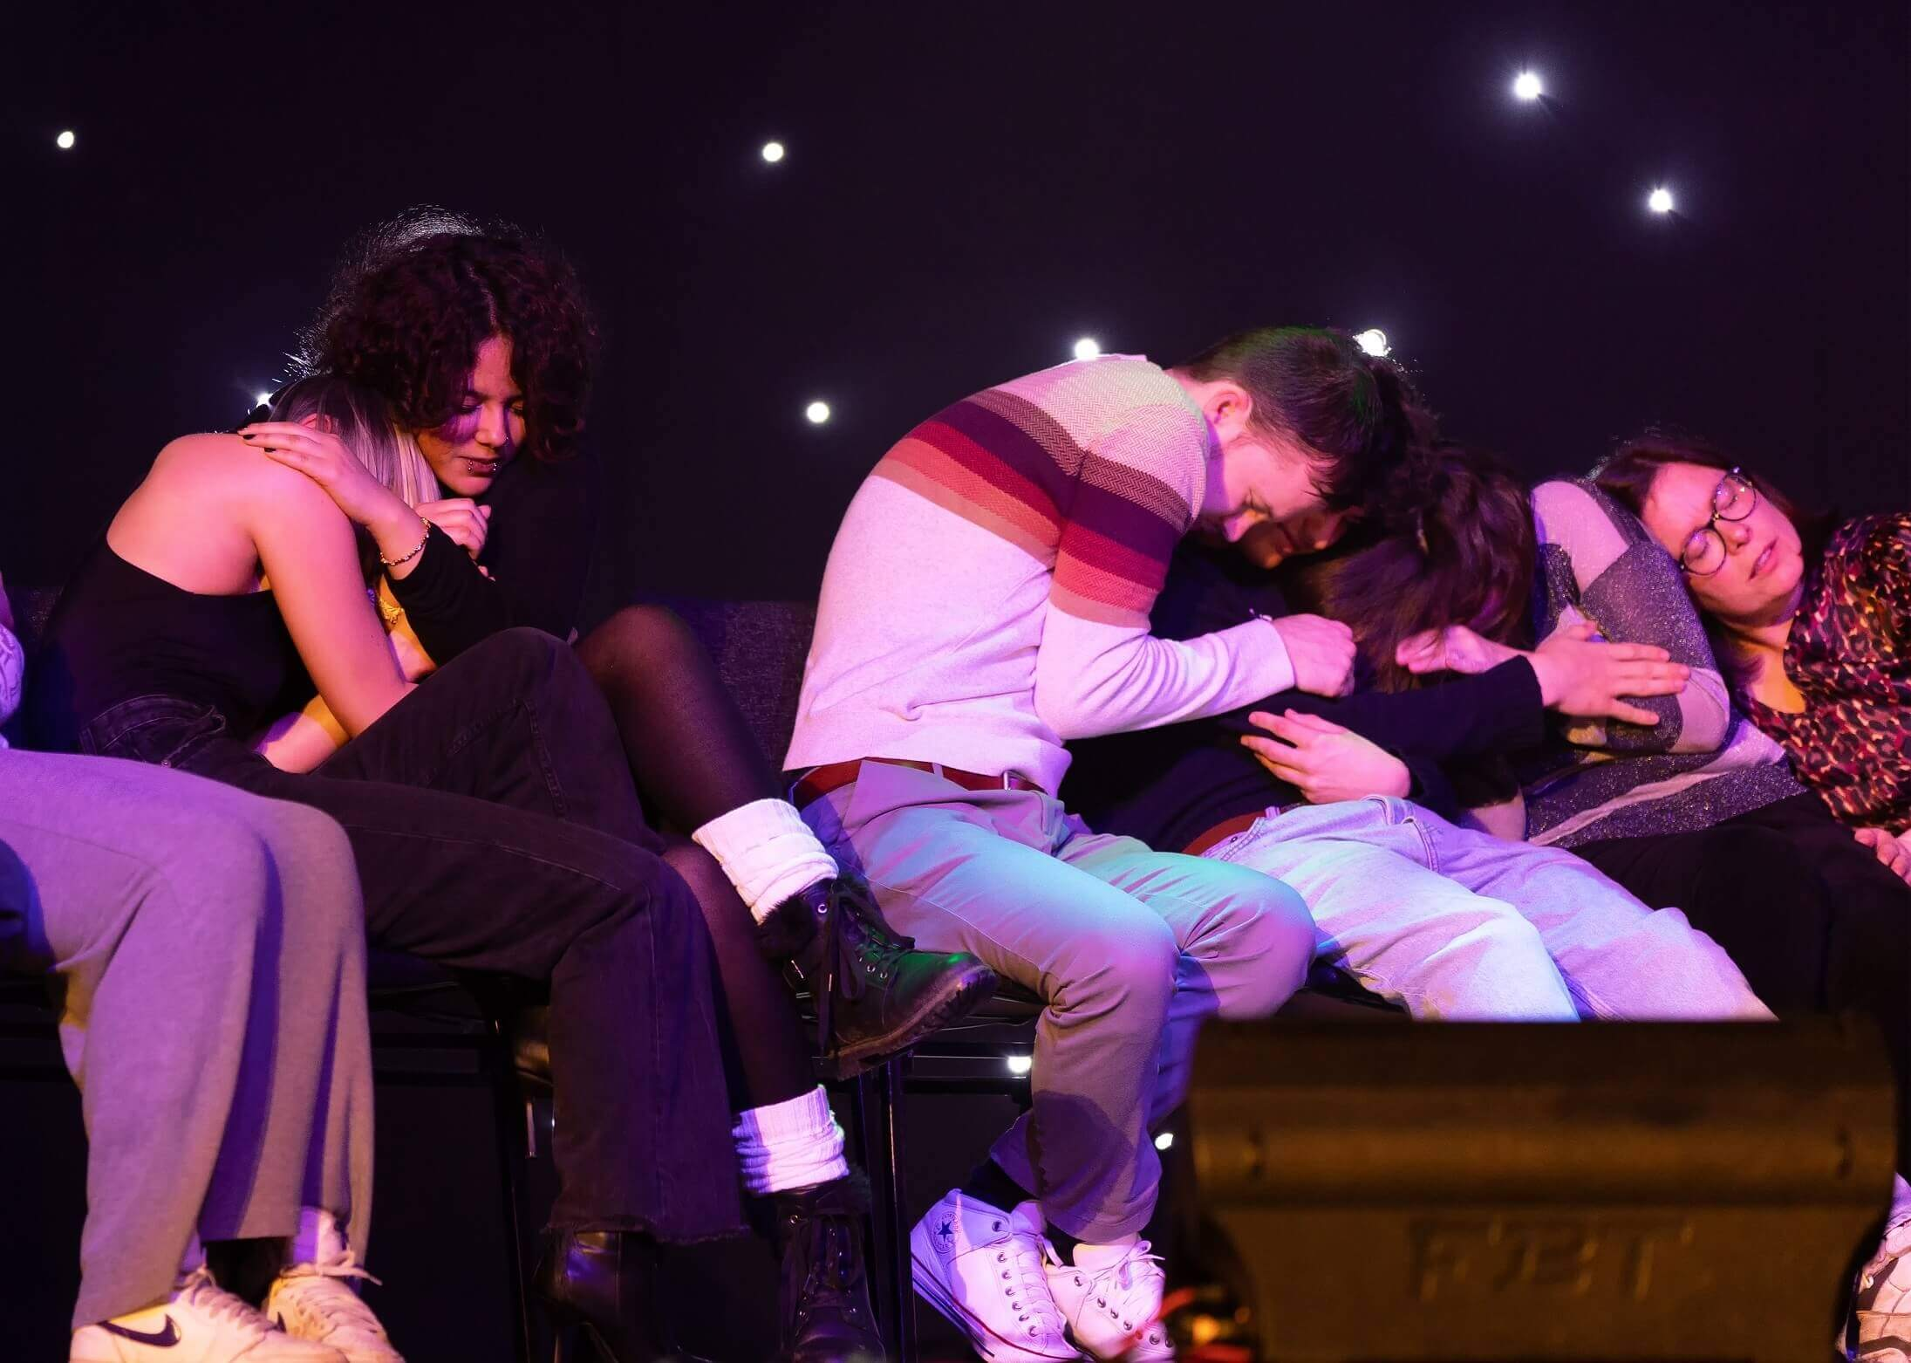

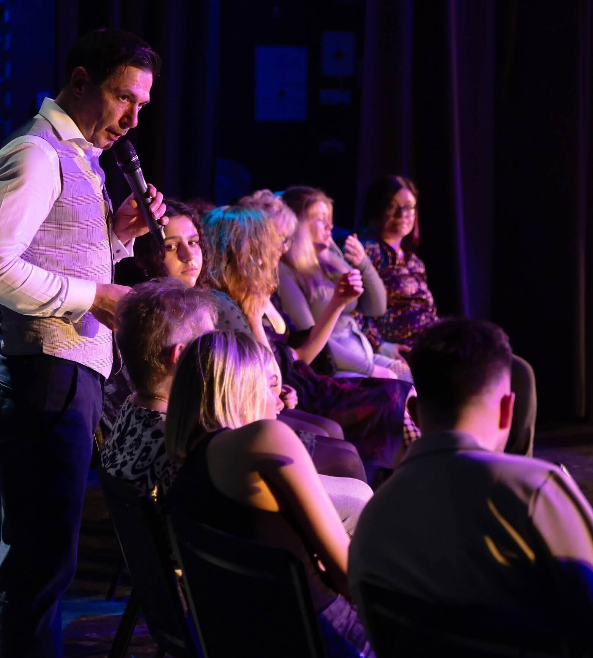
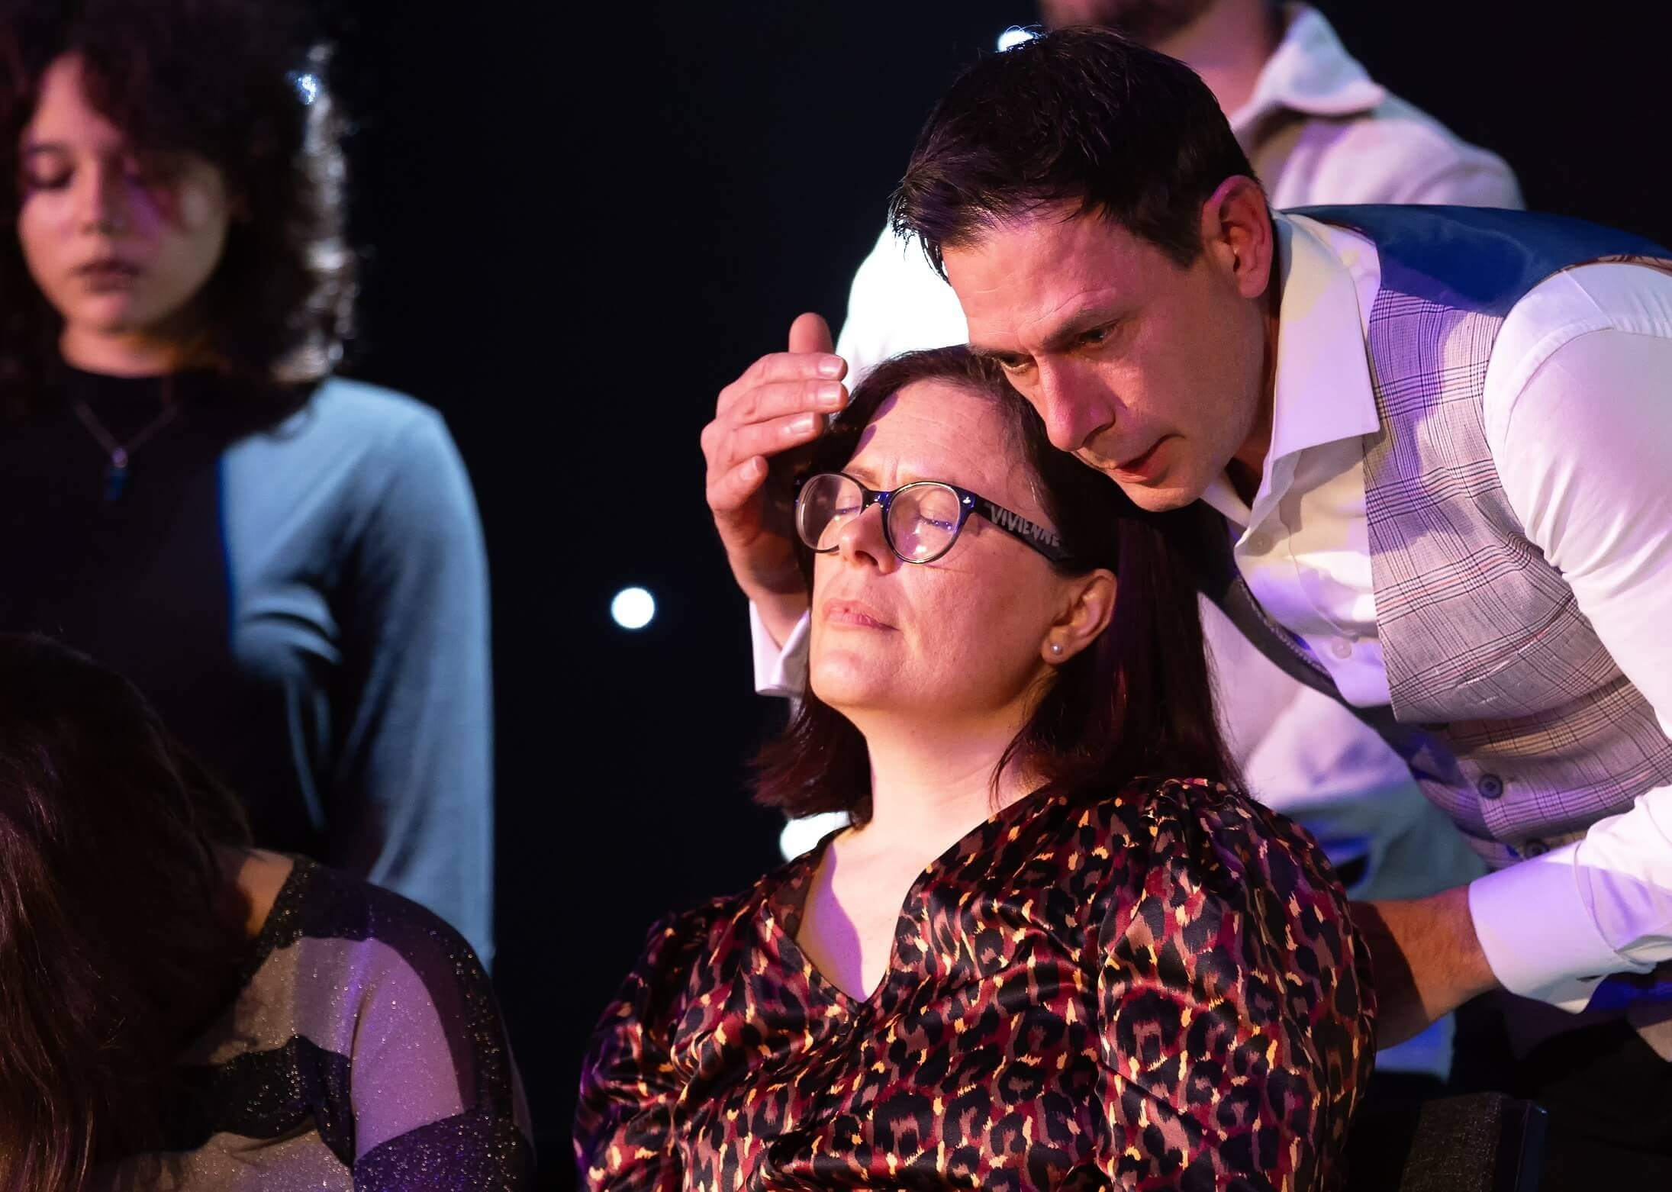
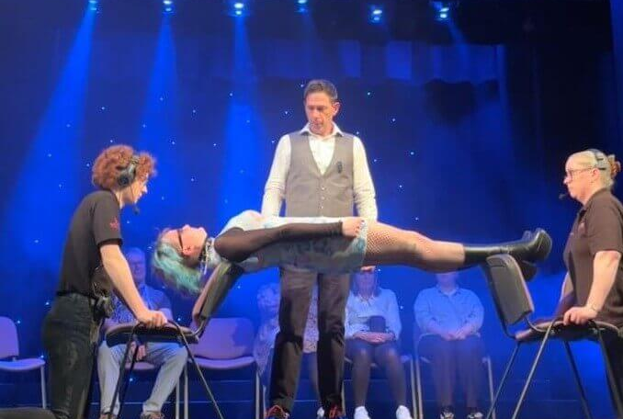
GALLERY
The media team work tirelessly to bring you some of the best footage from past shows.
Photographers and videographers get up close and personal, capturing every moment.

Slide 10
CHECK OUT THE
Customer satisfaction is the most important part of the whole production.
At The Poldark Show we are proud to have many positive reviews from clients, customers and audience members alike.
Take a quick look at just a few we've put together.
REVIEWS
"Completely mind blowing. Poldark is outstanding. I have seen hypnotist shows before but Poldark is the next level. I will definitely be travelling to watch this absolute showman again. The best show Belfast has had in years. A 5 Star show!"
⭐️⭐️⭐️⭐️⭐️
"I was standing right there in front of him and I still can't figure out how he managed to get him to balance on the chairs. There were no mirrors or props.
How is it done????“
⭐️⭐️⭐️⭐️⭐️
"Wow wow wow! What can I say! I am still speechless! Poldark show is absolutely brilliant, we had such a great time. A must see show“
⭐️⭐️⭐️⭐️⭐️
JOHN-MARK, BELFAST
ROB, RUGBY
NATALIE, RUGBY

Slide 11
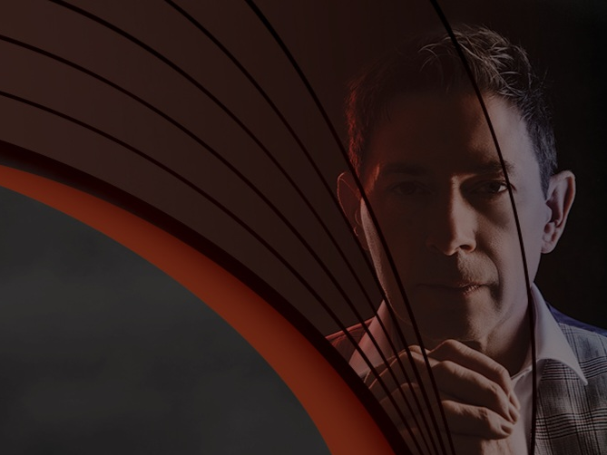
The beautiful venue choice and staging perfectly sets the scene for the style of The Poldark Show—Stage Hypnotist. The audience enters a church hall to find a velvet draped stage, and the sense of classy grandeur is a constant throughout the show.
Hypnotist Poldark is clearly a master of the craft, balancing respect for his participants with showmanship and entertainment for the offstage members of the audience.
Poldark’s brand of hypnosis is notable at this Fringe for its calming, meditative qualities in a field that currently seems to favour sharp, loud noises as a methodology. The Poldark version is more pleasant on the audience ear, even providing a relaxing environment for those who did not put themselves forward to be hypnotised. No one method of hypnotism will work on everyone, but at the reviewed show Poldark had a very respectable success rate, that gave him ample supply of hypnotised individuals for his demonstrations.
There is a gently comedic element to The Poldark Show, in a respectful and family friendly way. The hypnotised participants are not asked to do anything embarrassing. His final hypnotic demonstration is less for comedic effect and more just for the wow factor.
Even those who have seen a wide variety of other hypnotism shows are unlikely to have seen anything even remotely close to this. Poldark has a kind stage presence, and at the reviewed show some who did not manage to get hypnotised or were awoken from that state during the performance even played along just to try to help him out. However, ever the professional, Poldark spotted them quickly and found opportune moments to quickly ensure that they were okay and invite them to return to the rest of the audience.
The hypnotism takes the majority of the show’s run time, but Poldark does still take a moment to get the whole audience involved in a warm up imaginative exercise. It may start similar to an exercise often used in this kind of show, but once again Poldark demonstrates his unusual take on stage hypnotism—it’s actually a completely different exercise to what the audience probably anticipates.
The Poldark Show is without a doubt the place to be this Fringe for a pleasant hypnotic experience, whether as an onstage participant or a curious onlooker. Unfortunately the reviewed show was the final one of this Fringe, but Poldark will be heading out on tour, and will hopefully return to Edinburgh someday. Fans of being hypnotised or watching hypnotism are advised to look him up.
WORLD MAGIC REVIEW
Hannah S, Author. World Magic Review, 2024
THE POLDARK SHOW: STAGE HYPNOTIST
⭐️⭐️⭐️⭐️⭐️

Slide 12











CONTACT US
FACEBOOK
hello@poldarkshow.com
facebook.com/poldarkshow
CHECK US OUT
LINKEDIN
www.poldarkshow.com
linkedin.com/company/poldarkshow
LOCATION
INSTAGRAM
Worwickshire, UK
instagram.com/poldarkshow
TIKTOK
TikTok.com/@poldarkshow
YOUTUBE
Download as a File or view as a Flipbook
youtube.com/@PoldarkShow
© 2025 THE POLDARK SHOW All Rights Reserved.

